Slide 1
Ministry of Economy and Sustainable Development of Georgia
Overview of Energy Policy and Investment Opportunities in Georgia
Margalita Arabidze
Head of Energy Efficiency and Renewable Energy Policy and Sustainable Development Department
Jubo Turashvili
Head of Energy Policy and Investment Projects Department
Tbilisi, 2023

Slide 2
THE STATE ENERGY POLICY AND INTEGRATED NATIONAL ENERGY AND CLIMATE PLAN
National Energy Policy is based on the law of Georgia on energy and water supply (Article 7(1)). Policy is developed for 10 - year period and is the annex of National Energy Policy and includes the measures and target indicators which must Georgia achieve in 2030 and in perspective in 2050;
The NECP includes five key dimensions: Decarbonisation (GHG reduction and Renewable energy development), Energy Efficiency; Internal Energy Market; Energy Security; Research, Innovation and Competitiveness.
A strategic environmental assessment report has already been developed based on the scoping report.
The process of uploading the documents to the government is underway for their further approval.
Targets for renewable energies (RE), energy efficiency (EE) and reduction of greenhouse gas emissions (GHG) are agreed with the European Union and the Energy Community (EnC)
35% (47%) - reduction of greenhouse gases in 2030 compared to 1990 according to the nationally defined contribution;
27.4% - share of renewable energy in final energy consumption by 2030.

Slide 3
RENEWABLE ENERGY LAW
On December 20, 2019, the Law of Georgia "On Promotion of Production and Use of Energy from Renewable Sources" (also known as - Law on Renewable Energy) was adopted, which provides for the requirements of Directive 2009/28/EC.
PROGRESS:
8 by-laws have already been adopted;
In 2023-2024, additional by-laws on guarantees of origin, biofuel/biogas, etc. will be developed.
Also, an educational and certification program was prepared, which concerns the professional training of installers of renewable energy devices.
At this stage, the final comments from the interested parties are reflected in the document.
An initial version of the final version of the RIA has been developed.
Amendments to the law will be submitted to the Parliament by the end of the 2023 year.

Slide 4
LAW OF GEORGIA ON ENERGY EFFICIENCY AND
LAW OF GEORGIA ON ENERGY EFFICIENCY OF BUILDINGS
Amendments to the Law on Energy Efficiency have been prepared in accordance with the revised Energy Efficiency Directive (2018/2002/EU)
The Georgian Parliament will approve the draft law in 2023;
15 bylaws were approved;
The remaining 4 bylaws have been drafted and will be approved in the near future.
Amendments to the Law on Energy Efficiency of Buildings will be implemented during 2023, according to the updated EPBD
In 2021-2023, four bylaws were adopted.
7 bylaws have already been drafted, which will be approved during the current year.
Minimum Energy Performance Requirements (MEPR) for Buildings, Building Units or Building Elements came into force on July 1, 2023.

Slide 5
LAW OF GEORGIA ON ENERGY LABELLING
14 technical regulations of energy labeling have been developed.
3 technical regulations on labeling of various household appliances were approved;
6 technical registrations have been developed and consultations with interested parties are ongoing;
5 regulations have already been developed and need to be amended in accordance with the adapted regulations of the Energy Community.
Technical regulation of Eco-design
9 technical regulations of eco-design have been developed. Consultations with interested parties have started since March 2023.

Slide 6
PRIORITY DIRECTIONS FOR THE UPCOMING YEARS
Green Growth Strategy and Action Plan
Based on the Decree of the Government of Georgia of 2023 N627, the Green Growth Strategy and Action Plan Interdepartmental Council and Working Group were established.
Green Hydrogen
The Ministry of Economy and Sustainable Development of Georgia, in collaboration with the "Georgian Oil and Gas Corporation," Batumi Municipality City Hall, and KfW Development Bank, entered into a Memorandum of Understanding. The aim of this agreement is to collectively work on establishing a green hydrogen pilot project and its complete value chain, encompassing aspects like demand and supply. The formulation of the hydrogen strategy is currently in its preliminary phases, and to facilitate this process, a hydrogen committee has been founded, convening on a monthly basis.

Slide 7
Electricity
Installed capacity of Georgia accounts to - 4596 MW
Including:
Hydro Power Plants - 3394 MW
Wind Power Plant - 20.7 MW
Thermal Power Plant - 1181.4 MW

Slide 8
Development of Power Plants
Since 2012 66 HPPs has been put into operation
Total installed capacity – 1211 MW
Total annual generation - 6326 GWh
Total Investment - 1.901 bln.US$
Including:
63 HPPs
Total installed capacity – 729.19 MW
Total annual generation – 3037.9 GWh
Total Investment - 1.452 bln.US$
2 TPPs
Total installed capacity - 461,2 MW
Total annual generation - 3200 GWh
Total Investment - 415 bln.US$
1 WPP
Total installed capacity - 20.7 MW
Total annual generation - 88 GWh
Total Investment– 34 mln.US$
Currently, we have around 250 active agreements signed between the state and private investors on the development of renewable energy sources with an installed capacity of 3398 MW

Slide 9
Development of Power Plants and CFD Support Scheme
RES new scheme CfD (Variable Premium) is based on competition and market principles, which will contribute to the development of the energy sector of Georgia. Development of projects under the mentioned scheme will be carried out in accordance with the PPP legislation. The capacity auction will be held for upcoming 3 years in several lots, for a total amount not exceeding 1500 MW
Hydro power plants - 950 MW
Wind power plants - 250 MW
Solar power plants - 250 MW
Other renewables (Hydrogen, biogas, biomass, geothermal etc.) – 50 MW
The capacities will be auctioned in three phases (in proportion to the different technologies):
Phase I - 300 MW (2023)
Phase II - 400 MW (2023-2024)
Phase III - 800 MW (2024-2025)
Support conditions
Tariff: -- US cents/kWh - only price component is open
Support period: 15 years
Hydro power plant - 8 months (September - April)
Wind power plant - 9 months (August - April)
Solar power plant - 12 months
The Law of Georgia on Public-Private Cooperation (PPP law) of July 1, 2018
The Resolution of the Government of Georgia of August 17, 2018 N426 on the Approval of the Rules for the Development and Implementation of the Public-Private Cooperation Project
According to the mentioned law, the company can request a guaranteed electricity purchase tariff

Slide 10
Capacity Auction
The first auction for 300 MW installed capacity announced on February 10, 2023, has already been completed
Totally received 78 proposals for 943 MW
As a result of review and evaluation 27 companies have been identified as winners
300 MW were distributed as follows:
150 MW for Hydropower plants (run-off river)
70-70 MW for Wind and Solar power plants
10 MW for other renewable energy power plants*
*As other renewable energy projects were not presented in the auction, 10 MW distributed to wind and hydropower plants.
The median tariff was established as follows:
Hydro power plants - 6.850 USD cents
Wind power plants – 6.823 USD cents
Solar power plants - 6.367 USD cents
As a result of review and evaluation 27 companies have been identified as winners

Slide 11
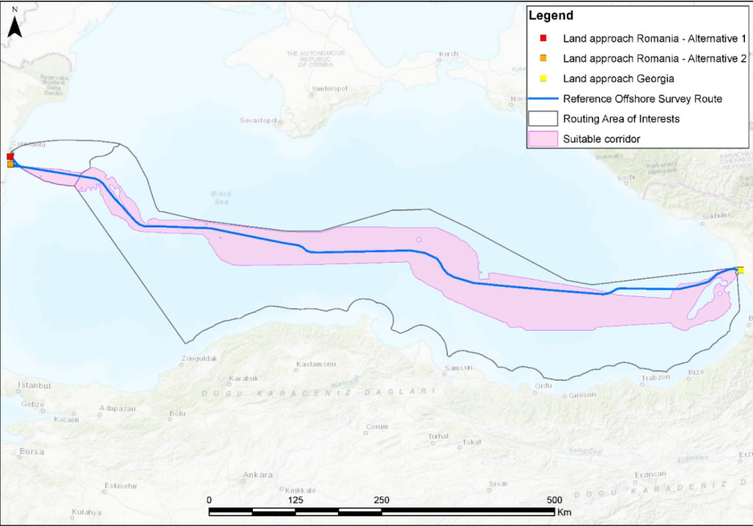
Black Sea Submarine Cable Project Feasibility Study
The Black Sea Submarine Cable project aims to connect Georgia to Romania by power and fiber optic cables:
Envisaged investment – 2,3 billion EURO
Commissioning year – 2030
Feasibility Study is underway implemented by Italian company CESI and will be finalized in the first half of 2024
Hungary has been added to the Feasibility Study of the Project, Bulgaria has also stated its interest to become more actively involved in the project
Based on the Agreement on Strategic Partnership in the Field of Green Energy Development and Transmission joint venture has been created comprising the Agreement member countries which will support further development of the project
Project development will continue with further planned studies – Black Sea underwater geophysical and geotechnical studies and Environmental and Social Impact Assessment study
The project is included in ENTSO-e TYNDP2024.

Slide 12
Thank you for your attention!
marabidze@moesd.gov.ge
jturashvili@moesd.gov.ge

