Slide 1
Project “Сonstruction of the Sary-Dzhaz HPP Cascade”
Ministry of Energy
of the Kyrgyz Republic

Slide 2
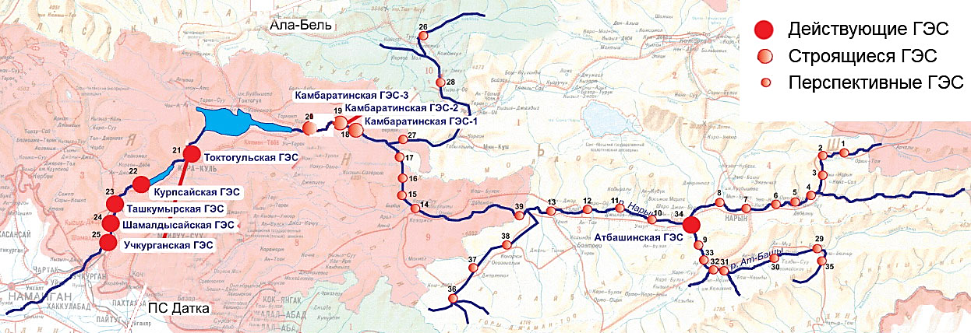
Total hydropower potential of the Kyrgyz Republic
The location of the hydroelectric power station on the river. Naryn
General indicators
Ala-Bel pass
Operating HPPs
Total natural hydropower potential of the Kyrgyz Republic - 142.5 billion kWh
The republic ranks third in the CIS after Russia and Tajikistan
The percentage of natural potential development is only 10%
HPPs under construction
Perspective HPPs
Kambarata-3 HPP
Kambarata-2 HPP
Kambarata-1 HPP
Toktogul HPP
Kurp-Sai HPP
Naryn river
Tash-Kumyr HPP
Shamaldy-Sai HPP
At-Bashy HPP
At-Bashy river
Uch-Korgon HPP
«Datka» substation
Industry Outlook
9 cascades of 38 hydroelectric power plants can be built on the Naryn river.
The total installed capacity of promising cascades is 9,271.2 MW
Average long-term annual production of more than 26 billion kWh of electricity

Slide 3
Hydropotential of the rivers of the Kyrgyz Republic
Hydropotential type | Hydropower potential of rivers
 | Power, MW | Power utilization factor | Power usage hours per year | Energy, billion kWh per year
Theoretical natural hydropotential | 28 040 | 1 | 8 760 | 245,6
Technical hydropotential, total | 28 040 | 0,58 | 5 082 | 142,5
Economic hydro potential used for electricity generation according to the calculation FDI "Tashgidroproekt" | 11 861 | 0,34 | 3 000 | 35,5
Hydropotential for use by small hydroelectric power plants | 300 | 0,40 | 3 500 | 1,05
Hydropotential used for the current time | 3 030 | 0,50 | 4 380 | 13,3
Hydropotential development percentage |  |  |  | 37,5%

Slide 4
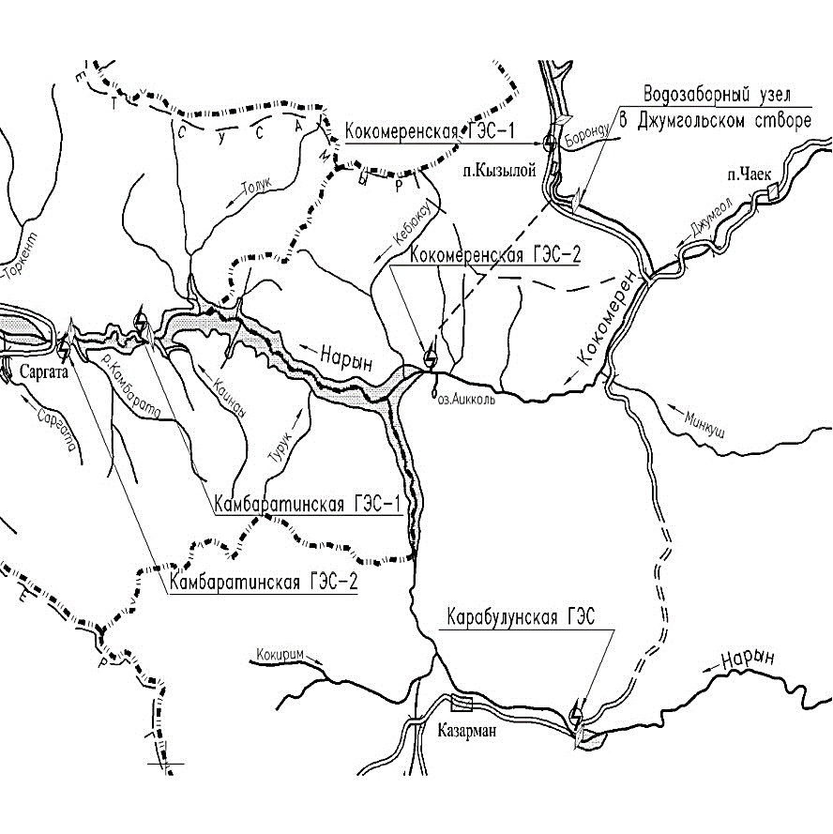
Suusamyr-Kokomeren HPP cascade. General information.
The project provides for the construction of 3 HPPs with a total installed capacity of 1305 MW with an average annual output of 3.3 billion kWh. According to the pre-feasibility study of the project, the cost is US $ 3.343 million.
Karakol hydroelectric power station
The object is located on the river. Kokomeren, which is a tributary of the river. Naryn is geographically located in the Zhayil district of the Chui region, also in the Toktogul district of the Jalal-Abad region.
Location
Kokomeren-1 HPP
Kokomeren-2 HPP
The estimated construction period for the cascade is 12 years.
Derivation tunnel of Kokomeren-2 HPP: length - 26 km, diameter - 7.6 m.
One of the tunneling options is mechanized with the use of the Robbins roadheader, which reduces the construction period by 2 years.
The design head of the Suusamyr-Kokomeren cascade is 508 m, which is 3.6 times more than the design head of the Toktogul HPP.
This gives a large production of e / energy with relatively low water consumption.
In 2012, the feasibility study was supplemented and updated by the Chinese corporation "Synohydro Ltd"
Some key features of the cascade
The cascade consists of 3 hydroelectric power plants
HPP name | HPP type | Reservoir volume, million m^{З} | Installed capacity, MW | Generation, million kWh | Normal (top)water level, м | Dam height, m
Karakol | Dam | 400 | 33 | 95,0 | 2177 | 99
Kokomeren-1 | Dam | 680 | 360 | 848,0 | 2020 | 230
Kokomeren-2 | Derivational | 19,5 | 912 | 2374,0 | 1730 | 42
TOTAL: |  | 1099,5 | 1305 | 3317,0

Slide 5
Investment indicators of the project
№ | Indicators | Unit measurements | The values
1 | Installed capacity | MW | 1 305
2 | Annual production | million kWh | 3 317
3 | Electricity consumption for own needs | million kW | 83
4 | Supplied electricity | million kW | 3 218
5 | Consolidated estimate of the cost of construction | USD million | 3 340
6 | Selling tariff | $/kWh | 0,03 | 0,045 | 0,0515
 |  | Kyrgyz som/kWh | 2,54 | 3,81 | 4,36
7 | Income from the sale of electricity | USD million | 97 | 145 | 166
8 | Production costs excluding loan servicing | USD million | 25 | 37 | 42
9 | Net profit after tax | USD million | 65 | 97 | 111
10 | Discounted payback period | years | 51,70 | 34,47 | 30,12
11 | Simple payback period, excluding costs (subparagraph 8) | years | 36,45 | 24,3 | 22,4
11 | Specific capital investments | $/kW | 2 559 | 2 559 | 2 559

Slide 6
Possible options for cooperation
1. Creation of a joint venture for the implementation of the project for the construction of the Suusamyr-Kokomeren HPP cascade with the following distribution of shares in the authorized capital of the enterprise:
Kyrgyz side - at least 51%;
Investor - up to 49%;
In-kind contribution of the Kyrgyz side:
Provision for temporary use of the existing infrastructure and land plots allocated for the construction of the Suusamyr-Kokomeren HPP cascade (with a land lease term of up to 49 years);
State preferences - exemption from taxes and customs payments related to activities during the implementation of the Project and payable by the Investor on the territory of the Kyrgyz side;
On the basis of the non-monetary contribution, it is assessed by an independent appraiser and additional share issues are organized, which must be redeemed by a potential investor as a founder of a joint venture (JV).
The rest of the investment for the completion of the project is attracted by the shareholders of the joint venture through loans and credits. The above means attracting direct investment from a potential Investor.
2. With the participation of a third party, the share of shares is distributed as follows:
Kyrgyz side - at least 51%;
Side number 1 - up to 24%;
Side number 2 - up to 25%.
In both forms of cooperation, it is assumed that after the completion of the project, the facility will come under the joint management of the Kyrgyz side and the Investor (s).

Slide 7
Possible options for cooperation
3. Implementation of the project in cooperation with the state within the framework of the law "On public-private partnership in the Kyrgyz Republic", including in the form of the following cooperation models:
BT, Build-and-Transfer - a private partner finances and builds an infrastructure facility and, after completion of construction work, transfers this infrastructure facility to a public partner, which, within the time period stipulated in the PPP agreement, pays the costs of the private partner for the construction of the infrastructure object.
Build-Lease-and-Transfer - BLT - a private partner finances and builds an infrastructure facility of a public-private partnership and upon completion of construction transfers it to a public partner, retaining the rights to lease an infrastructure facility for a certain period of time , after which the ownership rights to the infrastructure facility are automatically transferred to the state partner.
BOT, Build, Operate, Transfer - under this model of the Agreement, the Investor undertakes to build, finance the construction, operate and maintain the infrastructure facility for a certain period of time before the transfer of this facility to the state.
Build-Own-Operate-and-Transfer (BOOT) is a form of participation of a private partner in PPP projects, defined as "build, operate and transfer", except that after the expiration of the agreement, the private the partner transfers the object to the public partner.
Build-Transfer-and-Operate (BTO) - A public partner transfers an infrastructure facility to a private partner who builds it, taking on cost overruns, potential construction delays and associated risks. After the official acceptance of the infrastructure facility by the public partner, the ownership rights to it are transferred to the public partner, while the private partner operates it on behalf of the public partner.
DBFO (Design-Build-Finance-Operate) - design-build-finance-management. The state partner under this scheme retains the rights to the created infrastructure object and leases it to the project company for the period of the concession.

Slide 8
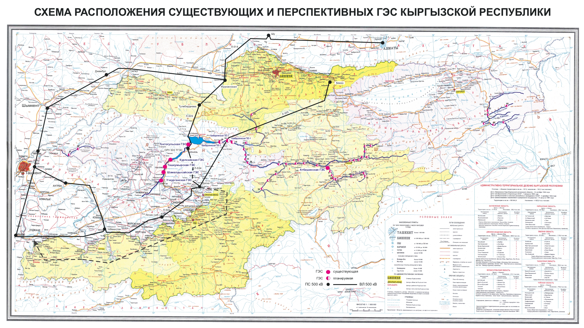
The Diagram of the Main Electrical Network of the Kyrgyz Republic’s Energy System.

Slide 9
The distribution scheme of electricity (export) to other states
KAZAKHSTAN
KAZAKHSTAN
UZBEKISTAN
CHINA
UZBEKISTAN
CHINA
TAJIKISTAN
AFGHANISTAN
PAKISTAN
TAJIKISTAN
CHINA

