Slide 1
Project "Construction of the Upper Naryn HPP Cascade"
Ministry of Energy
of the Kyrgyz Republic

Slide 2
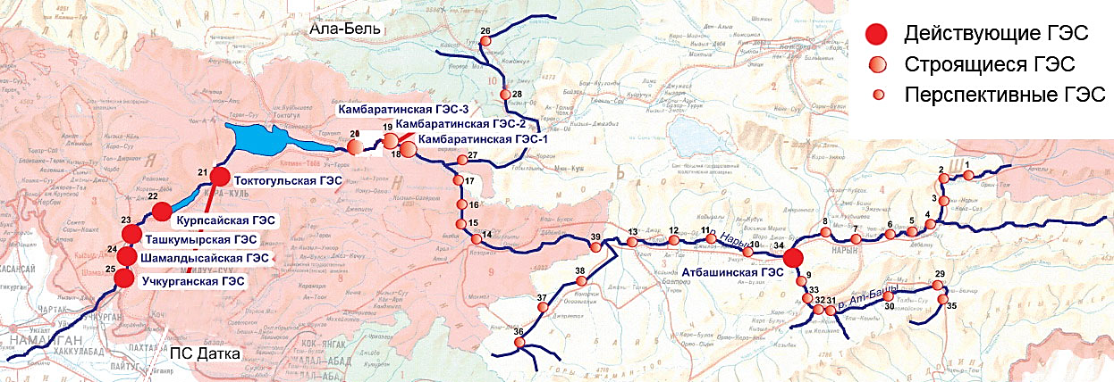
Total hydropower potential of the Kyrgyz Republic
The location of the hydroelectric power station on the river. Naryn
General indicators
Ala-Bel pass
Operating HPPs
Total natural hydropower potential of the Kyrgyz Republic - 142.5 billion kWh
The republic ranks third in the CIS after Russia and Tajikistan
The percentage of natural potential development is only 10%
HPPs under construction
Perspective HPPs
Kambarata-3 HPP
Kambarata-2 HPP
Kambarata-1 HPP
Toktogul HPP
Kurp-Sai HPP
Naryn river
Tash-Kumyr HPP
Shamaldy-Sai HPP
At-Bashy HPP
At-Bashy river
Uch-Korgon HPP
«Datka» substation
Industry Outlook
9 cascades of 38 hydroelectric power plants can be built on the Naryn river.
The total installed capacity of promising cascades is 9,271.2 MW
Average long-term annual production of more than 26 billion kWh of electricity

Slide 3
Hydropotential of the rivers of the Kyrgyz Republic
Hydropotential type | Hydropower potential of rivers
 | Power, MW | Power utilization factor | Power usage hours per year | Energy, billion kWh per year
Theoretical natural hydropotential | 28 040 | 1 | 8 760 | 245,6
Technical hydropotential, total | 28 040 | 0,58 | 5 082 | 142,5
Economic hydro potential used for electricity generation according to the calculation FDI "Tashgidroproekt" | 11 861 | 0,34 | 3 000 | 35,5
Hydropotential for use by small hydroelectric power plants | 300 | 0,40 | 3 500 | 1,05
Hydropotential used for the current time | 3 030 | 0,50 | 4 380 | 13,3
Hydropotential development percentage |  |  |  | 37,5%

Slide 4
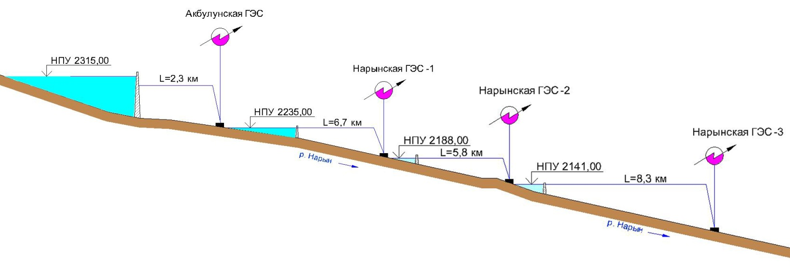
Upper-Naryn cascade of HPPs
HPP name | Installed capacity, MW | Average multi-annual generation, mln. kWh | Dam height, m | Construction period, months
Akbulun HPP | 87,4 | 345,5 | 75 | 72
Naryn HPP-1 | 47,7 | 187,5 | 20,5 | 36
Naryn HPP-2 | 47,6 | 188,8 | 19 | 36
Naryn HPP-3 | 55,0 | 220,5 | 9 | 48
Total | 237,7 | 942,4 |  | 86
Location:
The cascade is designed in the upper reaches of the Naryn river, with absolute elevations of 2100-2300 m. All stations are designed according to the dam-diversion scheme with small reservoirs, which reduces the area of flooded lands.
Construction infrastructure:
There exists a production infrastructure
Close proximity of the highway of the national importance
There is an existing 35 kV overhead power line on the right bank of the river
The main type of transport in the area of construction is automobile. The nearest railway station "Balykchy" is located at a distance of 183 km
The necessary land plots for the construction of hydropower plants are provided
The feasibility study of the project and a part of project documentation is developed
The chosen cascade scheme allows the full use of the fall of more than 30-km stretch of the river - the lower pool of the overlying plants is the reservoirs of the underlying ones
Notes:
4

Slide 5
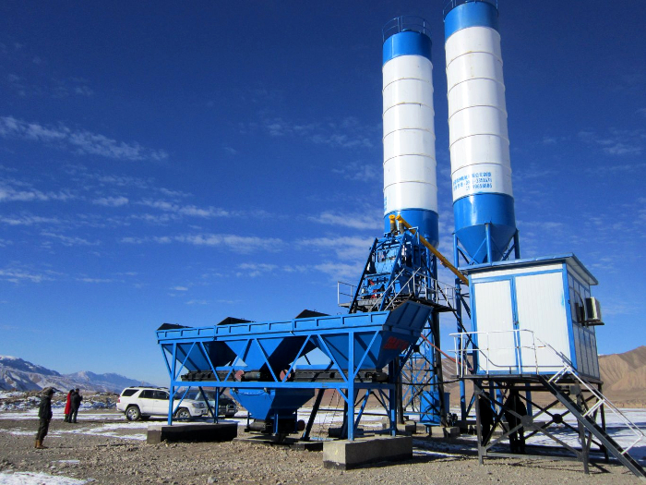
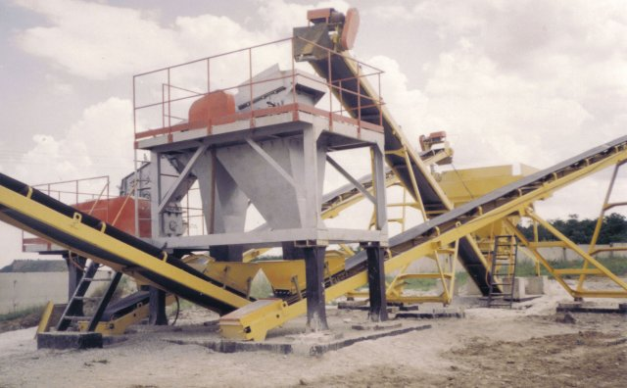
Completed works
Allocated 2459.04 hectares of land
The first stage of the shift camp for 450 people, readiness - 100%
Facility “Pioneer base”, readiness - 80%
Facility “Shift camp”, readiness - 95%
The facility of the main construction “Surface Spillway Naryn HPP-1” 1st stage, readiness 100%
The facility of the main structure "Diversion canal Naryn HPP-1" readiness - 10%
Concrete mixing plant – 35 m3/h, performed commissioning, at the moment plant produces concrete (produced 1,000.0 m3 of concrete)
Notes:
5

Slide 6
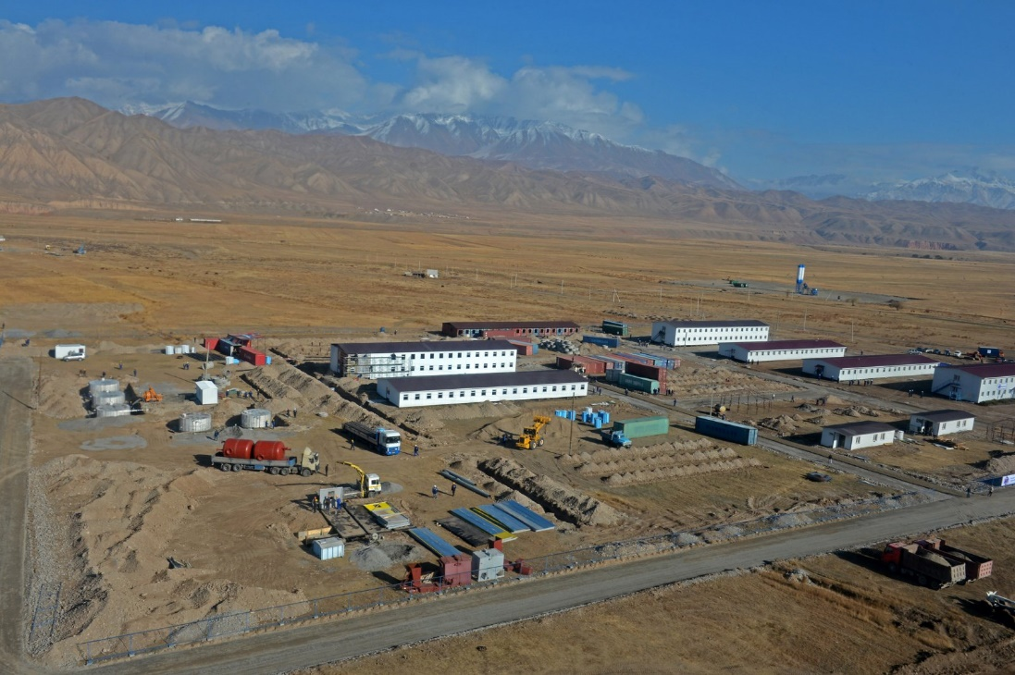
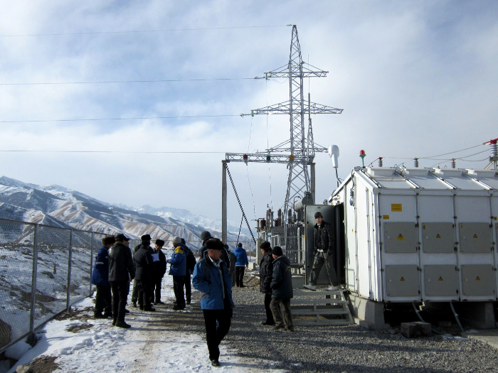
Completed works
Facility “Temporary bridge Naryn river”- readiness 30%.
Facility “Onsite road”, readiness 100%
Temporary power supply - have been put into operation: substation 35/10 kV, more than 10 km of 35 kV and 10 kV overhead lines, 8 transformers of various capacities
Production of inert materials - deployed two crushing and screening facilities, produced 20 thousand cubic meters of inert materials
Project survey work – development of project documentation for the construction of the main hydro unit cascade, working documents (Akbulun HPP and Naryn HPP-1). Topographical survey completed, main constriction plan refined.
Notes:
6

Slide 7
Possible options for cooperation
1. Creation of a joint venture for the implementation of the construction project of the Upper Naryn HPP cascade with the following distribution of shares in the authorized capital of the enterprise:
Kyrgyz side - at least 51%;
Investor - up to 49%;
In-kind contribution of the Kyrgyz side:
Provision for temporary use of the existing infrastructure (access roads, structures, etc.) and land plots allocated for the construction of hydraulic structures of the Upper Naryn HPP cascade (with a land lease term of up to 49 years);
State preferences - exemption from taxes and customs payments related to activities during the implementation of the Project and payable by the Investor on the territory of the Kyrgyz side;
On the basis of the non-monetary contribution, it is assessed by an independent appraiser and additional share issues are organized, which must be redeemed by a potential investor as a founder of a joint venture (JV).
The rest of the investment for the completion of the project is attracted by the shareholders of the joint venture through loans and credits. The above means attracting direct investment from a potential Investor.
2. With the participation of a third party, the share of shares is distributed as follows:
Kyrgyz side - at least 51%;;
side number 1 - up to 24%;
side number 2 - up to 25%.
In both forms of cooperation, it is assumed that after the completion of the project, the facility will come under the joint management of the Kyrgyz side and the Investor (s).

Slide 8
Possible options for cooperation
3. Implementation of the project in cooperation with the state within the framework of the law "On public-private partnership in the Kyrgyz Republic", including in the form of the following cooperation models:
Construction and transfer (BT, Build-and-Transfer) - a private partner finances and builds an infrastructure facility and, after completion of construction work, transfers this infrastructure facility to a public partner, which, within the time period stipulated in the PPP agreement, pays the costs of the private partner for the construction of the infrastructure object.
Construction, lease and transfer (Build-Lease-and-Transfer - BLT) - a private partner finances and builds an infrastructure facility of a public-private partnership and upon completion of construction transfers it to a public partner, retaining the rights to lease an infrastructure facility for a certain period of time , after which the ownership rights to the infrastructure facility are automatically transferred to the state partner.
Construction, operation and transfer (BOT, Build, Operate, Transfer) - under this model of the Agreement, the Investor undertakes to build, finance the construction, operate and maintain the infrastructure facility for a certain period of time before the transfer of this facility to the state.
Build-Own-Operate-and-Transfer (BOOT) is a form of participation of a private partner in PPP projects, defined as "build, operate and transfer", except that after the expiration of the agreement, the private the partner transfers the object to the public partner.
Build-Transfer-and-Operate (BTO) - A public partner transfers an infrastructure facility to a private partner who builds it, taking on cost overruns, potential construction delays and associated risks. After the official acceptance of the infrastructure facility by the public partner, the ownership rights to it are transferred to the public partner, while the private partner operates it on behalf of the public partner.
DBFO (Design-Build-Finance-Operate) - design-build-finance-management. The state partner under this scheme retains the rights to the created infrastructure object and leases it to the project company for the period of the concession.

Slide 9
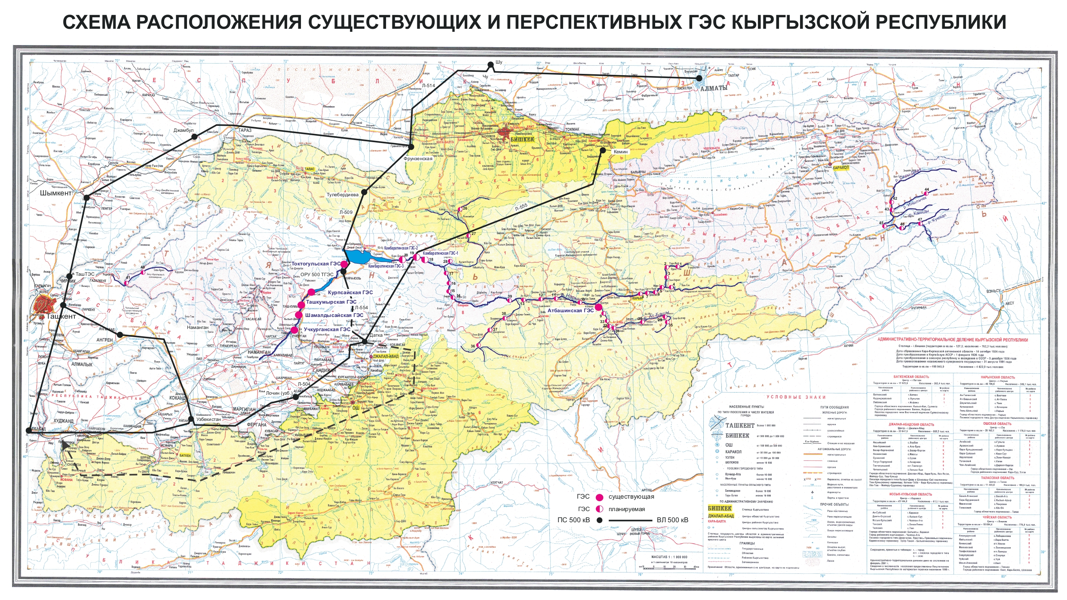
The Diagram of the Main Electrical Network of the Kyrgyz Republic’s Energy System.

Slide 10
The distribution scheme of electricity (export) to other states
KAZAKHSTAN
KAZAKHSTAN
UZBEKISTAN
CHINA
UZBEKISTAN
CHINA
TAJIKISTAN
AFGHANISTAN
PAKISTAN
TAJIKISTAN
CHINA

