Slide 1
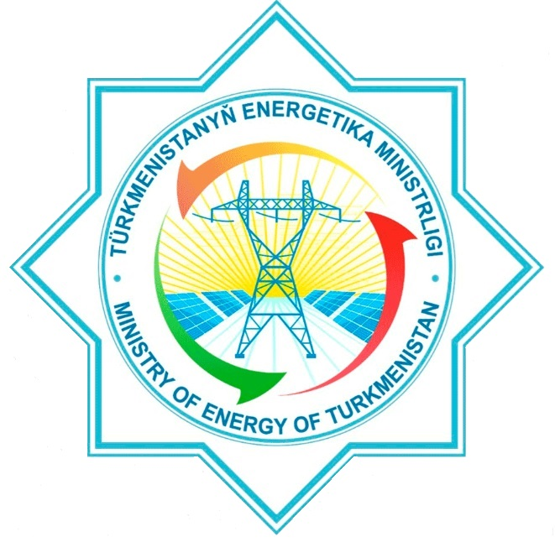
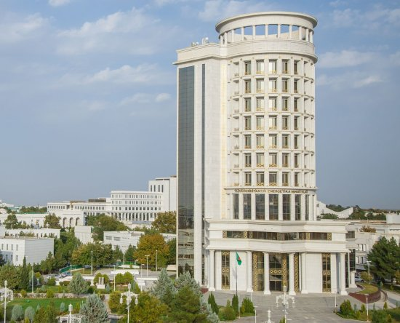
Ministry of Energy of Turkmenistan
.

Slide 2
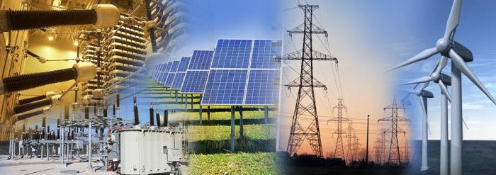
Energy Sector of Turkmenistan
Under the leadership of our Honourable President of Turkmenistan Serdar Berdimuhamedov, the national energy sector, being the basis of the national economy, ensures steady advancement of all aspects of our life. It once again proves that this sector has not only a huge input but also a priority in the development of Turkmenistan. Currently, the national energy system meets the demand not only of domestic consumers, but also exports electricity to the neighboring countries.

Slide 3
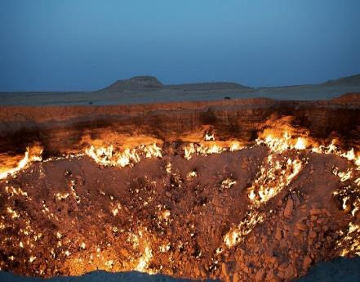
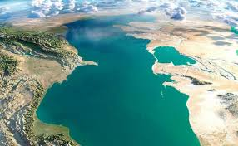
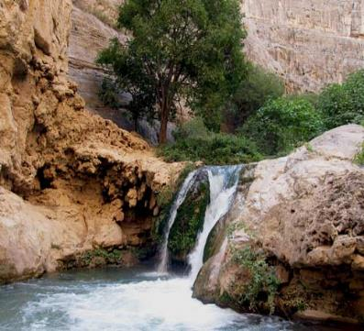
Main tasks for Advancing the Renewable Energy Sources in Turkmenistan
Ensuring dynamic and sustainable development of the national economy, environmental protection, rational use of natural resources, careful attitude to and saving the richest flora and fauna of the country for the favor of the next generations of Turkmenistanis are the main priorities of our Government and all governmental bodies of Turkmenistan
.

Slide 4
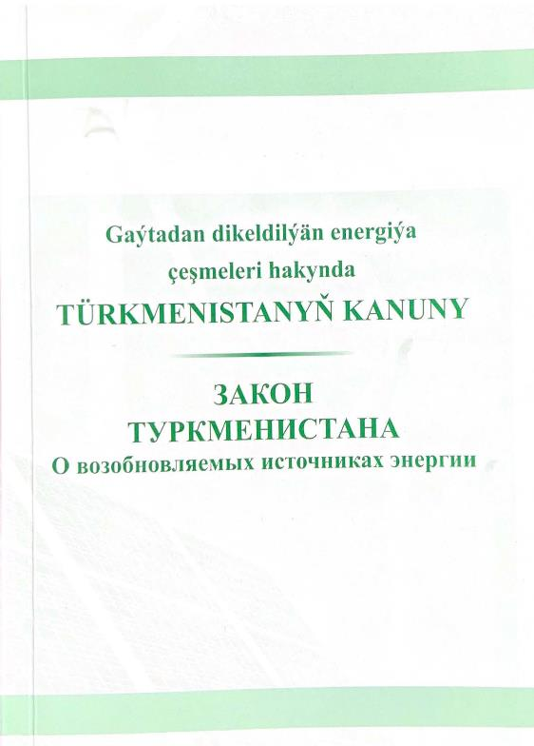
Law on Renewable Energy Sources
In order to protect the environment, rationally use the natural resources and gradually move to "green economy", the 13th session of the Mejlis of Turkmenistan adopted the Law on Renewable Energy Sources on 13 March 2021. The Law establishes the legal, organisational, economic and life pillars and regulates the legal relations arising out of the use of renewable energy sources.

Slide 5
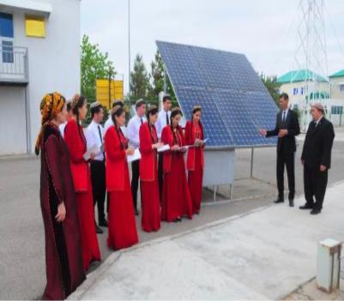
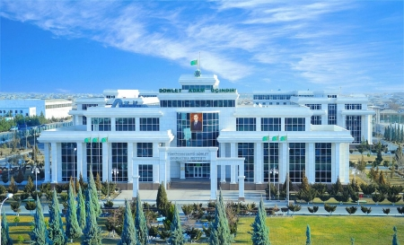
Educating and training the experts in the renewables
On the basis of the State Energy Institute of Turkmenistan located in the city of Mary, a Research & Development Centre for Renewable Energy Sources was set up.
The main objectives of the Centre are: the energy personnel training, study of innovative technologies for RES development, continuous research of international RES projects, advanced training resulting from experience exchange with foreign institutions and preparation of proposals for the most energy efficient sites for installing the renewable energy technologies.

Slide 6




International cooperation
Turkmenistan is a member of the International Renewable Energy Agency (IRENA), and besides, our country cooperates with the UN Development Programme, OSCE, Asian Development Bank and other international organisations.

Slide 7
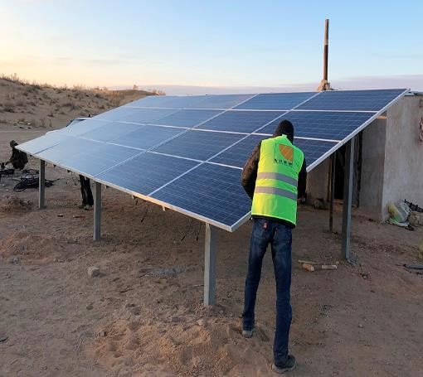

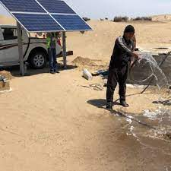
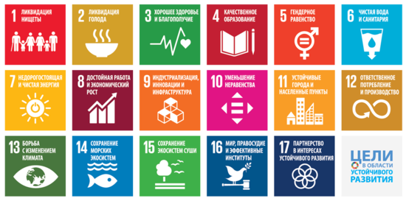
Main objectives of Turkmenistan on RES development
In order to diversify Turkmenistan's fuel and energy resources, to increase the export potential of electric energy, to provide the remote populated areas with affordable and sustainable energy, to improve the social life of the population and to boost the industrial development, as well as to achieve the goals of sustainable development and the Paris Climate Agreement, the National Strategy for the Development of Renewable Energy of Turkmenistan until 2030 and the Programme on Developing the Renewable Energy of Turkmenistan until 2030 were approved by the Decree of the President of Turkmenistan.

Slide 8
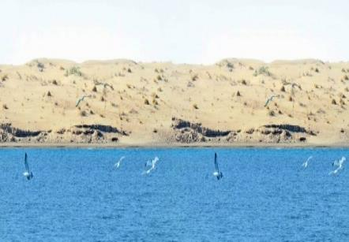





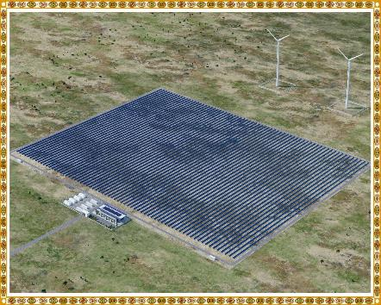
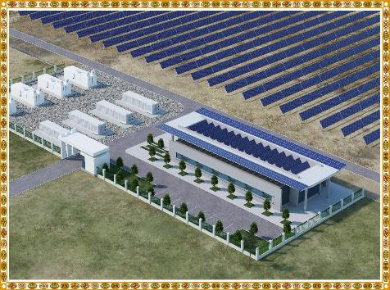
To ensure sustainable development of the renewables and the secondary energy resources, development of energy-efficient and innovative technologies, recently the President has adopted a number of important documents. These are the State Energy Saving Programme for 2018-2024, the Concept of Development of Altyn-Asyr Region around the Turkmen Lake for 2019-2025. Within the framework of this Concept, construction of a hybrid solar and wind power plant of total capacity of 10 MW is currently underway in the Serdar district of Balkan province

Slide 9
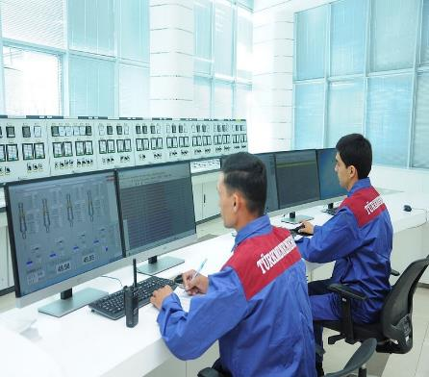
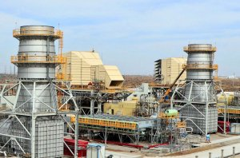
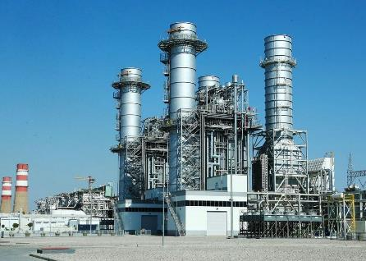
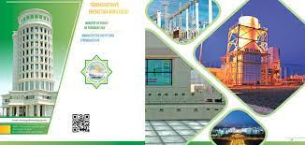
Regarding the secondary energy resources, a combined cycle power plant of capacity of 1,574 MW was commissioned at the Mary HPP in 2018, of which about 550 MW is produced by a gas turbine heat emissions, and construction of an identical power plant in the Balkan province was launched in early November 2023. In addition, in the near future, it is planned to convert the Akhal and Dashoguz power plants to the combined cycle.

Slide 10
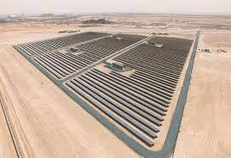
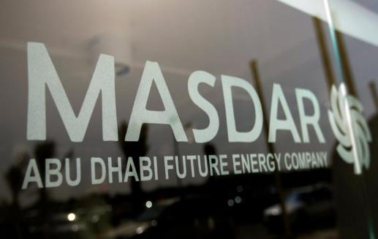
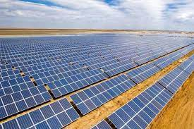
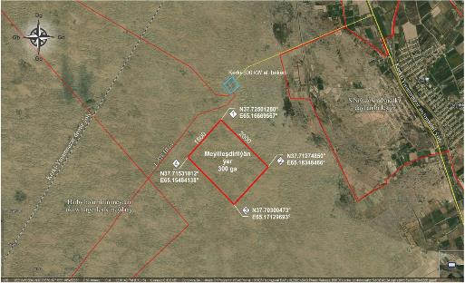
Prospects on the RES
Project proposed to invest in:
The Development Cooperation Agreement was concluded by and between the State Electric Power Corporation "Turkmenenergo" and Abu Dhabi Future Energy Company PJSC "Masdar". According to the Agreement, it is planned to build a photovoltaic power farm of 300 MW capacity.
Project location: Turkmenistan, Lebap province, Kerki district (a land plot has been allocated).
Project implementation period 1.5-2 years

Slide 11
Prospects on the RES
This project will generate electricity during the daytime, annual output will exceed 900 million kWh. This will reduce the burning of the natural gas to generate electricity, which in turn will reduce CO2 emissions

Slide 12
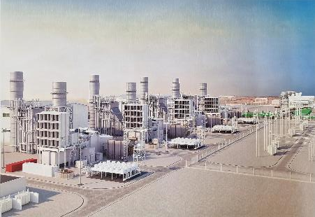
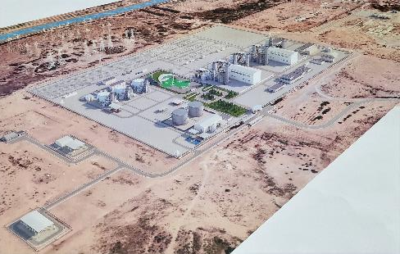
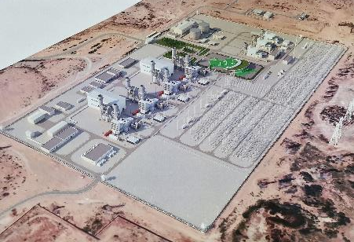
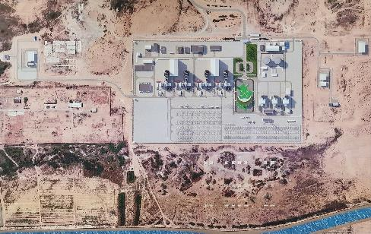
Prospect on CO2 reduction
Project proposed to invest in:
According to the Programme on Socio-Economic Development of Turkmenistan for 2022-2028 it is planned to construct two combined cycle gas turbines with capacity 2x120 MW.
Project Location: Turkmenistan, Akhal province, Akbugday district (Conversion of existing gas turbines of Akhal power plant to combined cycle).
Project implementation period 2.5-3 years

Slide 13
Prospect on CO2 reduction
This project will generate the electricity by using the heat emitted by the gas turbine units. The annual output will be more than 1.5 billion kWh. This will save the natural gas of more than 500 million m3 per year.

Slide 14

In conclusion, I would like to emphasise that it is important to comprehend that overarching transition to RES is a challenge for all countries. It is necessary to study and develop new technologies of energy generated by RES. Therefore, the programmes and projects aimed at reducing the greenhouse gas emissions into the air are the next steps in the country's transition to renewable energy sources and emission reduction technologies.
Thank you!

