Slide 1
EV development in Norway
Sveinung Kvalø
Senior Advisor
Norwegian EV Association
sveinung@elbil.no
Notes:
I would like to thank you for the opportunity to contribute with sharing the Norwegian EV experience.

Slide 2
Norwegian EV Association
Non-profit NGO
Over 120,000 members (EV drivers)
55 employees
Our goal:
Electrify transport as fast as possible!
Notes:
I work in the Norwegian EV Association, we are a non-profit NGO with over 120.000 members, our members are EV drivers, people, no companies. Today we are 55 employees working in the association. Our goal is to electrify transport as fast as possible to the benefit of our climate and environment.

Slide 3
Norway new car sales
Source: OFV.no
Notes:
This is the market for new car sales in Norway today, where pure battery electric vehicles have a total market share of 83 percent.
As you can see, the development of sales for internal combustion engine vehicles have had a steep decrease in the last years.
The 17 percent includes both regular and plug in hybrid cars. When we say EV we mean fully electric vehicles, not including plug-in hybrid vehicles.
Furthermore…

Slide 4
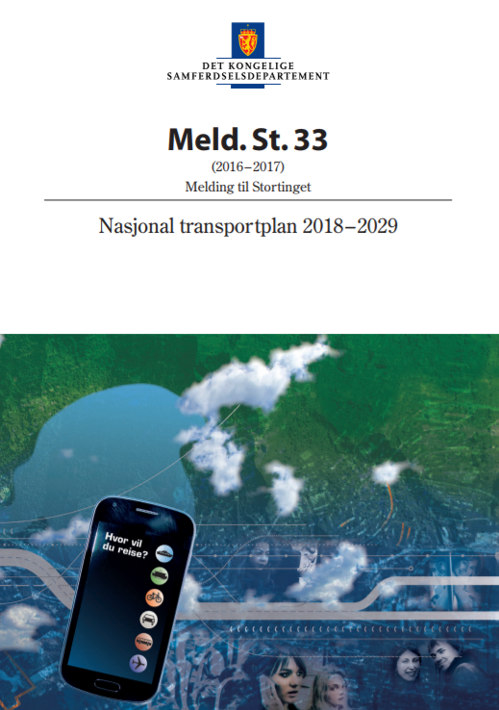
Norway’s 2025-goal
National Transport Plan 2018–2029:
“All new passenger cars and light vans sold in 2025 shall be zero-emission vehicles.”
Notes:
In 2017 the government decided on a national target, saying that all new passenger cars and light vans sold in 2025 shall be zero- emission vehicles.
This is a bipartisan target, with broad support in parliament. It is a goal, not a ban, so it will not be illegal to buy or sell regular internal combustion vehicles.
But the government have to deliver on policies that will actually enable us to reach the goal they have set.

Slide 5
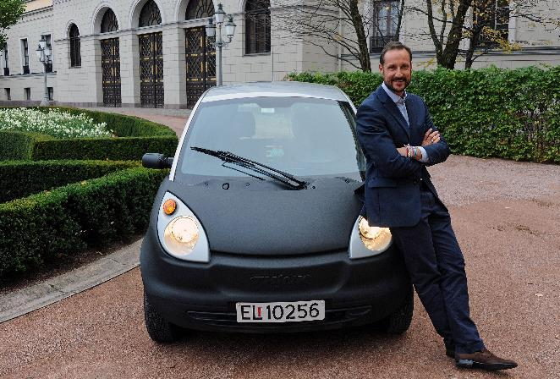
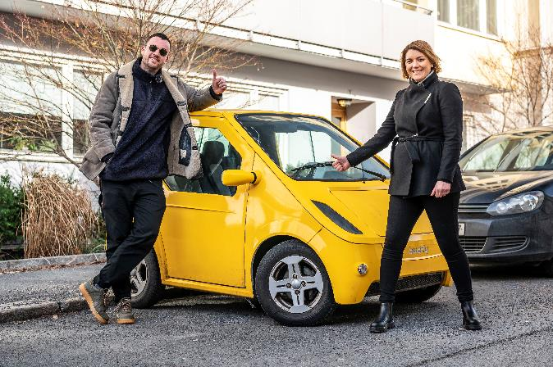
Think and Buddy, an important beginning
Notes:
And this was how the EV adventure in Norway started out, an important part of the beginning in Norway was these two small cars…

Slide 6
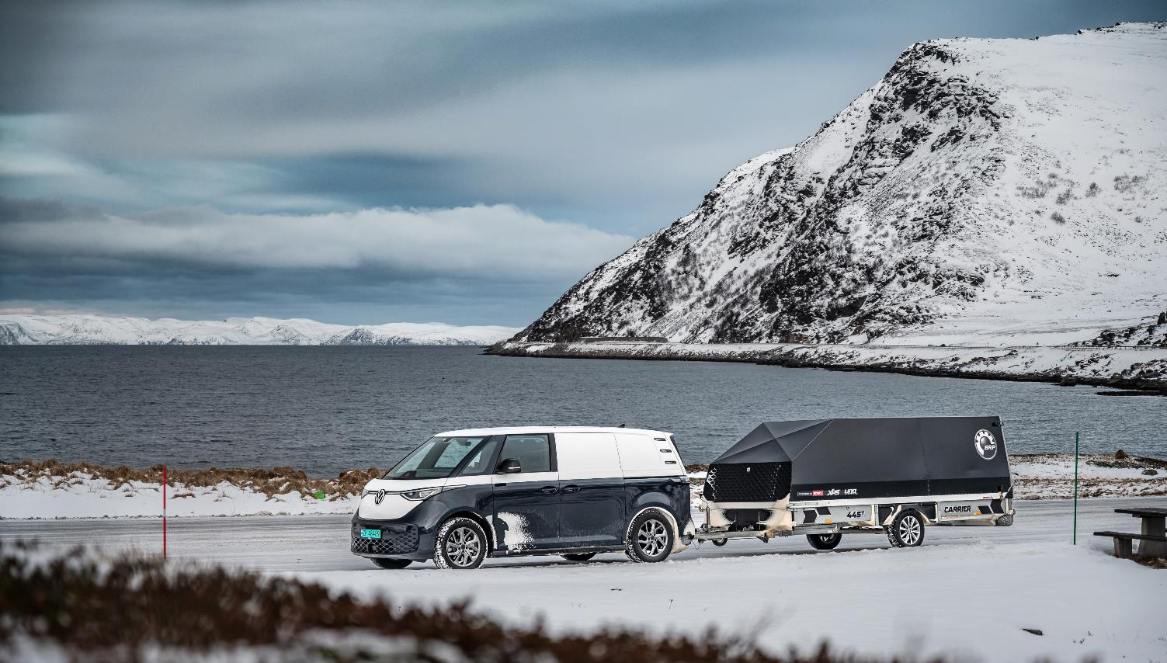
Noe om klima? Et bilde?
Source: IEA Global EV Outlook 2023
Notes:
Today, everyday life as an EV driver in Norway can look a bit more like this. The cars are now regular cars, suitable for every purpose! Like this EV towing a snow mobile in the far north of norway, where temperatures can hit below 25 minus degrees celcius.

Slide 7
EV sales per county
Troms
Finnmark
Plug-in hybrids are not included in the numbers!
Nordland
Møre og Romsdal
Trøndelag
Oppland
Sogn og Fjordane
Hedmark
Hordaland
Akershus
Buskerud
Oslo
Telemark
Østfold
Rogaland
Vestfold
Vest-Agder
Aust-Agder
Source: OFV
Notes:
This map shows the EV sales per county in Norway for 2022.
And even in Finnmark county, all the way up north, above the arctic circle, over half of the new passenger vehicles bought, were fully electric. It is an amazing development.

Slide 8
Are we there yet?
23,6%
2.200.000 to go
5,5%
480.000 to go
8,3%
14.200 to go
1,4%
67.200 to go
Source: OFV, October 2023
Notes:
But are we there yet? It takes a long time to change entire fleets. This is why you need to think ahead and start early. For passenger cars, we have come a long way because we started early, the other modes of transportation are lagging behind, but the development will go faster there (less vehicles and TCOs starting to look favorable for commercial vehicles and buses).
AS OF OCTOBER 2023
675 000 electric passenger cars
28 000 electric vans
1285 electric buses
960 electric HDV.

Slide 9
How are we doing it?
Notes:
… So how are we doing it?

Slide 10
Policy is key
Buying or leasing:
No registration tax
Zero VAT
LCV support scheme
Using:
Toll roads 0% to 50%
Ferries 50%
Discounted parking fees
Access to bus lanes
Notes:
Policies have been key to the Norwegian development. We have made EV affordable and able to compete on price when people are choosing what type of new car they want to buy.
The politicians has made sure that buying or leasing an EV is favourable: it has been no purchase tax on EVs while ICE vehicles have had high purchase tax.
There has been zero value added tax on EVs while ICE vehicles have had this tax, and there has been a support scheme for light commercial vehicles.
For using the car: EV drivers have only had to pay up to 50 percent of what petrol or diesel or hybrid car owners have had to in the toll roads of Norway.
EVs have also enjoyed 50 percent discount on ferries compared to other vehicles, and many cities in Norway are connected by car ferries. There has also been discounted parking fees for EVs and access to bus lanes.
The Norwegian EV policy package has been exactly that: a package that has brought on the success.

Slide 11
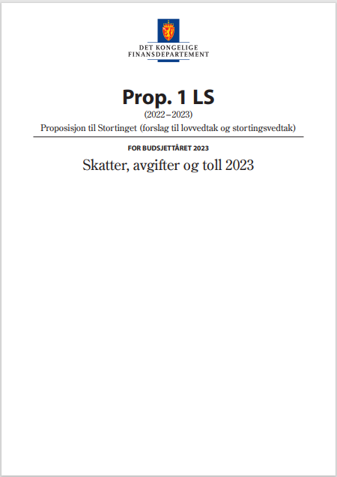
Purchase taxes
25% VAT
Registration tax based on CO2 and weight
In 2022:
Average for cars with emissions: 10 250 USD
Higher for petrol/diesel, lower for plug in hybrids
Notes:
So a bit more about the purchase taxes that are levelling the playing field between EVs and ICE vehicles.
We have 25 % value added tax on new vehicles. And a registration tax you pay when you buy a new car, that is based on emissions and weight. This is a high tax, it is expensive to buy cars with high emissions in Norway, as you can see in 2022 the average purchase tax for cars with emissions was at 10.250 US dollars.
So.. In Norway we had high taxes for purchasing new cars, when Evs came along we gave them excemptions to incentivize zero emission vehicles. If a country do not have taxes on cars it can be a good idea to introduce taxes on the purchase of polluting vehicles. That way you will have income from the taxes, whereas we in Norway now struggle a bit with the loss of income.
But the point is:
We like to call this is an Environmental choice tax. Clever way to tax emissions before they happen. The point of environmental taxation should not be that you keep polluting and pay for it – but that you STOPP POLLUTING in the first place.
Also: we tax something that you don’t have to do. You don’t have to buy a new car with emissions anymore.
People with higher incomes are the ones buying new cars, thats how it is. Now we get them to buy zero emission cars insted of cars with emissions.
Now 18 % of the second hand car market is electric in Norway, making EVs more affordable for all. And most people buy a second hand car in Norway, but you have to start with the new car market to achieve this transition in the second hand market as fast as we have.

Slide 12
Which of these four were most important to you in your decision to start driving an EV?
The Norwegian EV driver survey 2023
Notes:
And is all this necessary, or why do we do this: When we map the EV drivers, it has been crystal clear from the beginning that Economy and low cost is the main motivation for most EV drivers in their decision to start driving an EV.
Norwegians are not more environmentally friendly than other people in the world.
It has been beneficial to choose an EV when buying a new car in Norway, that is why people have picked EVs.

Slide 13
Charging

Slide 14
Fast charging network
Initial public support to private companies, mostly done by 2017
Total support 350 mill NOK (32 mill USD)
Fast charging stations every 50 km on all main roads (7 500 km)
Commercial success after 2017
Notes:
We have also done a few things to secure an intial fast charging network. This was a good start, and today the market has taken over the development, because they now see it as a good market case to construct fast charging stations.
In total we have spent about 350 million kroners (32 mill USD). We would recommend that if you do anything similar, have a set of criteria in order to receive funding, for example station size and universal payment solutions etc. We started with smaller stations, it is wise to plan for expansion from the start, and best if you can do that on already constructed charging stations, just expanding with more chargers.

Slide 15
Norway’s electricity market
Notes:
In 2022 we produced 146 TWh of electricity in Norway. Consumption was 135 TWh, of whcih 1,5 TWh was used for electric transport.
Most of the electricity in Norway is being used for industry and heating. An EV uses approximately the same amount of electricity as the average water heater in a household.
If all transport was battery electric, total consumption to passenger cars would be 6-7 TWh, while vans, buses and trucks would use 10-12 TWh. In total around 12 per cent of total production in 2022.
Today we are a net exporter. If no new capacity is added we would og from exporting 11 TWh to importing 5 TWh
So we are talking of a relatively small impact in the Norwegian electricity market.

Slide 16
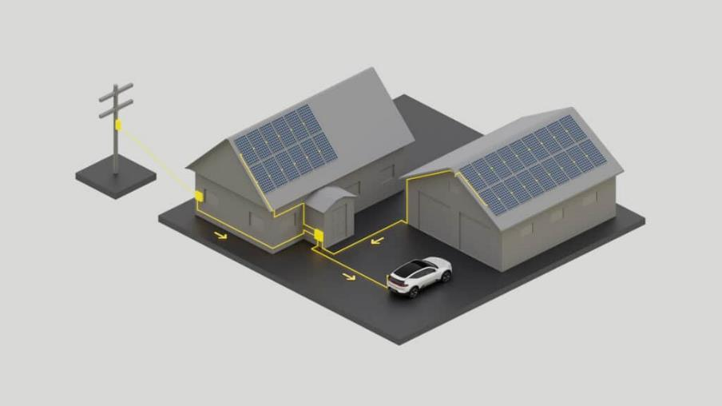
Smart charging opportunities
Dynamic charging
Grid balancing?
Electricity backup?
Notes:
Dynamic charging is the opportunity to decide the time of electricity use. It can be done by smart apps, or simply by plugging in when electricity is cheap, typically at night or in the weekends. We know from our surveys that EV drivers already is charging smart. Most EV drivers charge during the night when there is a lot of capacity in the electricity net.

Slide 17
Monthly expenses – Diesel car vs. EV
Notes:
This pircture shows the difference in monthly expenditure for a diesel car and an EV the last three years.
As you can see, electricity is a lot cheaper than diesel, from 40 to 100 USD per month. The large price difference is largely due to the fact that a diesel car uses 2-3 timers more energy than an EV. Most of the energy from a diesel engine is transferred to heat. Most of the electricity in the EV battery is used to move the car.
Savings per year: 1000 USD

Slide 18
Motor vehicles per 1000 people
CAREC countires
Selected other countires
 | Population (mill) | Motor vehicles per 1000 people
Georgia | 4,0 | 281
Kyrgyzstan | 6,5 | 223
China | 1 439,3 | 214
Kazakhstan | 18,8 | 207
Azerbaijan | 10,1 | 124
Turkmenistan | 6,0 | 107
Uzbekistan | 33,5 | 98
Mongolia | 3,3 | 71
Afghanistan | 38,9 | 47
Tajikistan | 9,5 | 38
Pakistan | 220,9 | 26
 | Population (mill) | Motor vehicles per 1000 people
United States | 331,0 | 816
Poland | 37,8 | 642
Japan | 126,5 | 590
Germany | 83,8 | 574
Norway | 5,4 | 522
Russia | 145,9 | 388
Brazil | 212,6 | 298
Colombia | 50,9 | 126
Egypt | 102,3 | 109
Nigeria | 206,1 | 64
India | 1 380,0 | 44

Slide 19
From 2% to 10% market share
Norway
2.5 years
UK
1.5 years
Germany
1 year
Source: ACEA

Slide 20
Thank you!
sveinung@elbil.no

