Slide 1
Development of energy sector
of the Republic of Uzbekistan

Slide 2
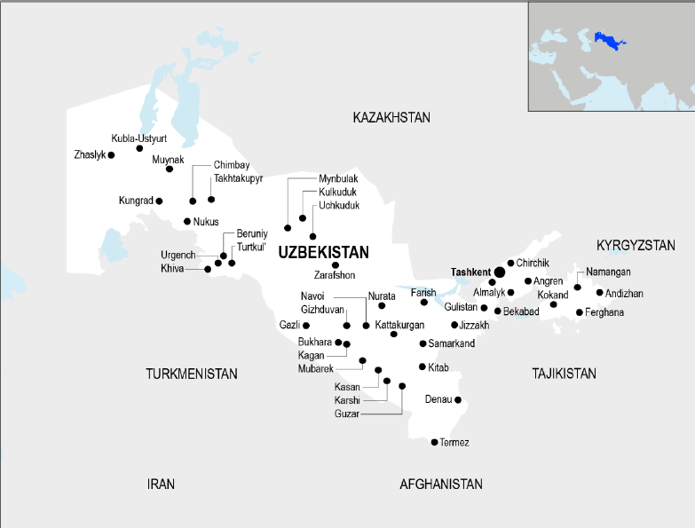
ECONOMIC INDICATORS
Capital
Political system
Tashkent
Presidential multi-party democratic republic
Area
Official currency
"Soum" – UZS (UZS/USD) 1$=12300)
450 000 sq.km
Population
Languages
36 mln
Uzbek (official), Russian (commonly used)
Uzbekistan is a landlocked country in Central Asia with a more than 36 million population. Uzbekistan has made significant progress in recent years in the development of its energy sector. The country is rich in natural resources, including oil, gas, and coal, and has a growing renewable energy sector. Uzbekistan has set ambitious goals for renewable energy production, aiming to generate 25 percent of its electricity from renewable sources by 2030. The government has also implemented policies to attract foreign investment in the energy sector, including the creation of special economic zones for renewable energy development.In addition to its domestic energy activities, Uzbekistan also plays an important role in regional energy cooperation. The country is part of the Central Asia South Asia Electricity Transmission and Trade Project (CASA-1000), which aims to interconnect electricity markets in Central and South Asia.
2

Slide 3
REFORMS IN THE ENERGY SECTOR OF UZBEKISTAN
Uzbekhydroenergo
~ Total installed capacity: 2 225 MW
Private stations
~ Total installed capacity: 5 174 MW
including, 2 Photovoltaic PP
Electricity market models and transition stages identified
Together with experts from the WB, ADB and EBRD, a new version of the Electricity Law is being developed
The Concept for the provision of the Republic of Uzbekistan with electric energy for 2020-2030 was developed
The Electricity Grid Code is being developed with technical support from the World Bank and The ADB
Transition to IEC standards in progress
Thermal Power Plants
~ Total installed capacity: 11 932 MW
“National Electricity Grids of Uzbekistan”
Transportation of electrical energy from generation sources through high voltage networks
Regional Electricity Networks
Distribution and supply of electrical energy to consumers through distribution networks.
Uzbekneftegaz
extraction and processing of hydrocarbon raw materials
Uztransgaz
Transportation, building up the export and transit potential of natural gas
Hududgaztaminot
distribution of natural gas to the end consumer
3

Slide 4
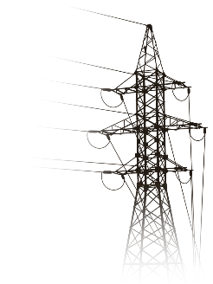
REFORMS IN THE ENERGY SECTOR OF UZBEKISTAN
Achievements of energy sector reforms
The following results will be achieved through the transition to a competitive electricity market, which will be created as a result of the reforms
In accordance with the decision of the President of the Republic of Uzbekistan dated March 27, 2019, at the first stage of reforming the electric power industry, the activities of “Uzbekenergo” JSC were reorganized;
The wholesale price of electricity will be optimized;
Energy sector reforms
In connection with the construction of private stations not participating in the PPP, the issuance of indirect government guarantees by the PPP will be suspended, which puts pressure on the state’s credit rating;
Investment deals worth US$17.7 billion were concluded based on PPP contracts;
The first stage of the transition to the “Free Market” model for electricity is the creation of the current “Single Buyer” model;
As network operators become profitable, it becomes possible to attract corporate loans that do not require government guarantees;
Based on technical support from the European Bank for Reconstruction and Development and the World Bank, together with international experts, a new edition of the Law of the Republic of Uzbekistan “On electrical energy” has been developed;
As a result of competition, power plants and retailers are motivated to reduce costs;
The system of tariffs for social protection of the population will be preserved.
The following areas were identified as priorities for continuing reforms in this area:
A concept has been developed for a phased transition to the mechanisms of the wholesale and retail electricity market for 2023-2030;
Regulations on the Agency for Energy Market Regulator has been developed.
Development of regulatory documents;
SCADA system, digitalization and network management;
Personnel training and development;
Preparation of market infrastructure (online platform).
4

Slide 5
Current condition of Power sector
Generation capacities of Uzbekistan:
Power generation:
Power plants | Электр станциялари | 77 | 19 554 MW
 | including:
 | Thermal power plats | 18 | 16 906 MW
 | Hydro power plants | 54 | 2 225 MW
 | PV stations | 2 | 200 MW
 | Block stations | 3 | 223 MW
+10,4%
Mln.kW hour
+7,4%
+4,6%
2019 2020 2021 2022
Existing substations:
Substations | Жами
 | 500 kV substations | 7 | 7 540 МVА
 | 220 kV substations | 72 | 20 158 МVА
 | 35-110 kV substations | 1793 | 21 950 МVА
 | 6-10/0,4 kV transformers | 94 538 | 17 150 МVА
Takhiyatash TPP
AKSA Tashkent TPP
Chorvoq HPP
Tashkent TPP
Chichik-Bozsuv HPP
Angren TPP
Tashkent HPC
Yangi Angren TPP
Turakurgan TPP
Tashkent-500 substation
Andijan HPP
Tuyamuin HPP
Fargona TPP
Existing lines:
Navoi TPP
Sirdarya TPP
Uzbekistan-500 substation
Lochin-500
substations
Total length of overhead lines are: 284 299 km
AKSA Bukhara TPP
Navoi PV
Farkhad HPP
Korakul-500 substation
Samarkand HPP
220-500 kV lines – 10 730 km
Sugdiyona-500 substation
Guzar-500 substation
Khisorak HPP
Talimarjon TPP
35-110 kV lines – 28 966 km
Muborak TPP
Tupalang HPP
Surkhan-500 substation
Low voltage distribution lines – 244 603 km
5

Slide 6
POWER GENERATION
Goal achievement
Operating PPP projects - 28. Total amount - 12 billion dollars, 12.9 GW of power.
They are:
9 projects of thermal power plants construction (4,0 billion dollars, 6,0 GW):
19 photovoltaic and wind (8 billion dollars, 6,9 GW).
Result:
the possibility of 67.2 billion kWh electricity generating.
Saving 7.6 billion cubic meters of gas for electricity generation.
Implemented PPP projects – 7;
(915 mln dollars. 1354 MW)
One more project until the end of the year (140 mln dollars; 220 MW, Syrdarya region)
78,7 bln. kWh per year
106,5 bln. kWh per year
19,5 GW
27,4 GW
6

Slide 7
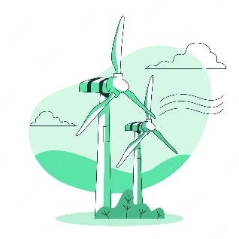
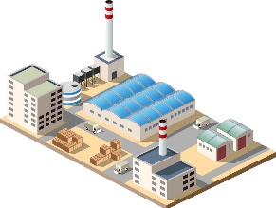
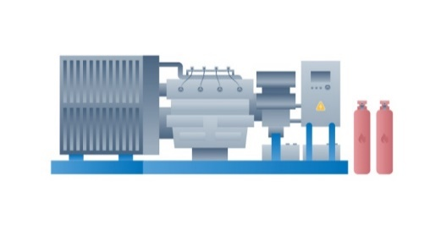
SIGNED AGREEMENTS ON PPP TERMS
Photovoltaic plants
12 projects with a total capacity of 3 847 MW (3,7 bln.dollar)
Wind farms
7 projects with a total capacity of 3 100 MW (4,3 bln.dollar)
28 projects
with a total capacity of 12.955 GW and the cost of $11.87 billion
Combined cycle power plants 5 projects with a total capacity of 5 114 MW (3,3 bln.dollar)
Gas-piston power plants 4 projects with a total capacity of 894 MW (0,5 bln.dollar)
7

Slide 8
IMPLEMENTED AND PLANNED WORKS IN THE FIELD OF RENEWABLE ENERGY SOURCES
Works performed in 2017-2023
Number of announced tenders | 7
Number of projects | 19
Number of agreements signed | 19
Capacity of signed projects | 6 947 MW
Adopted legal documents on projects | 10
The cost of signed projects | 8 billion dollar
Commissioned solar power plants
Investors | Masdar (UAE) Total Eren (France)
Total capacity of projects | 200 MW
Electricity generation per year | 500 million kWh
Saving natural gas per year | 150 million cubic m
Reducing greenhouse gas emissions per year | 200 thousand tons
Funds raised by investors within the project | 200 million dollar
1
1+
< 1
[200 to 300[
[300 to 400[
400+
400+
400+
400+
1
400+
400+
Plans till 2030
Total RES capacity | 15 000 MW
Solar photovoltaic stations | 10 000 MW
Wind farms | 5 000 MW
Total annual output | 40 billion kWh
Total annual gas savings | 11,4 billion cubic meters
Total cost of investment | 14 billion dollar
Permanent jobs created | 3 000
Prevention of CO2 emissions | 16 million tons
WPP 100 MW
WPP 200 MW
SPP 100 MW
SPP 100 MW
WPP 500 MW
SPP 220 MW
WPP 1500 MW
SPP 400 MW
SPP 100 MW
WPP 500 MW
SPP 220 MW
WPP 500 MW
SPP 500 MW
SPP 500 MW
SPP 1000 MW
8
SPP 250 MW
SPP 300 MW
SPP 457 MW

Slide 9
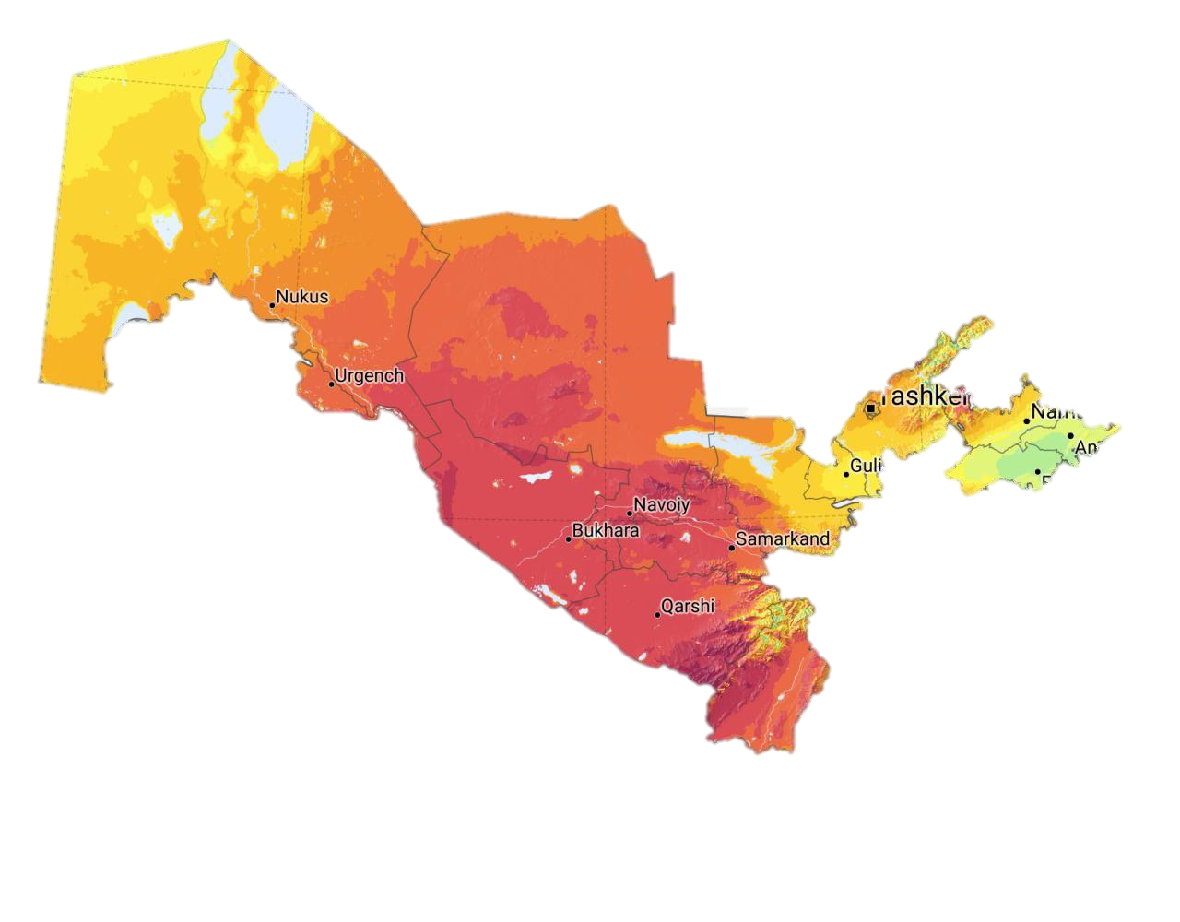
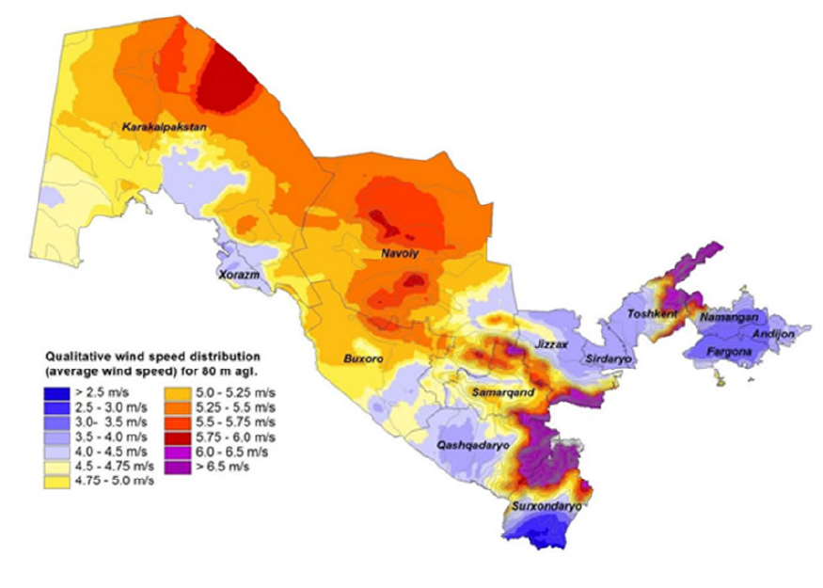
UZBEKISTAN RENEWABLE ENERGY POTENTIAL
Diversification of energy supply by sources
Solar potential
Wind potential
HPP
$6,2 billion investment in 2023-2030 to develop 60 new projects and upgrade 18 existing stations
PPP
51 billion tons of oil equivalent
WPP
360 million tons of oil equivalent
9

Slide 10
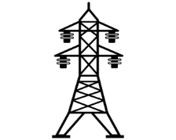
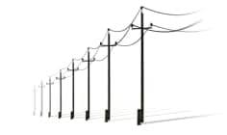
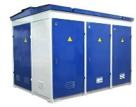
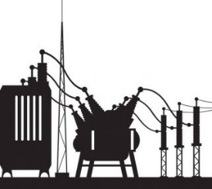
POWER GRID
Ўзбекистон
Республикаси
Инвестициялар
ва ташқи савдо
вазирлиги
Works done in 2017-2021 years
ACTIVE VOLUME
Perspective work to be done until 2026 year
0,4-10 kV network
500 kV
220 kV
500 kV
220 kV
1902,3 km
2314,7 km
7 units
2 390 km
70 units
8 151 km
80,8
thousand km
110 kV
35 kV
4 290 km
278,6
thousand km
1 850 km
110 kV
35 kV
0,4-10 kV
704 units
16 034 km
70,5 thousand km
92,1
thousand units
1048 units
13 489 km
35-500 kV network
500 kV
220 kV
6 units
24 units
6-10 kV
0,4 kV
90 320 units
100 262 km
138 369 km
20,3
thousand units
110 kV
35 kV
90 units
120
units
6-10/0,4 kV
20 060 units
10

Slide 11
GENERAL ISSUES IN ENERGY SYSTEM OF UZBEKISTAN
Loses in production
(up to 15%)
Low efficiency of old technologies
Risks of development of hydro power plants
Risks with development of renewable energy plants
Renovation and modernization of existing power plants: introduction of new technologies and equipment upgrades to improve efficiency and reliability.
Implementing new technologies and energy efficiency methods: applying innovative solutions to reduce energy consumption and optimize processes.
Utilization of solar and wind energy: development and increase of the share of solar and wind power plants for the production of clean energy sources.
Development of hydropower potential: Research and development of hydropower resources to increase the share of hydropower plants.
Diversity of energy sources to reduce import dependence
Development of energy cooperation with other countries
Loses in electricity grids (up to 14%)
Diversity of energy sources to reduce import dependence: developing different energy sources to reduce the risks associated with import dependence.
Developing energy cooperation with other countries: Partnering and cooperating with other countries in the energy field to share expertise and resources.
Renovation and modernization of grids: introduction of new technologies and equipment upgrades to improve efficiency and reliability.
One of the biggest problem on energy system is that 40% of generation consist of old Soviet technologies, even the Government trying step by step modernizing and build up new generation capacities, the system has much loses in fuel and electricity. I hope due to exchange program I learn up about ways of minimizing the loses.
11

