Slide 1



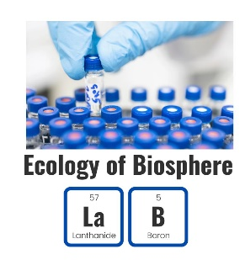

Air quality in Central Asian cities
Nassiba Baimatova,
Ph.D., Associate Professor
Head of the ”Ecology of Biosphere" laboratory
Faculty of Chemistry and Chemical Technology,
Al-Farabi Kazakh National University, Almaty, Kazakhstan

Slide 2
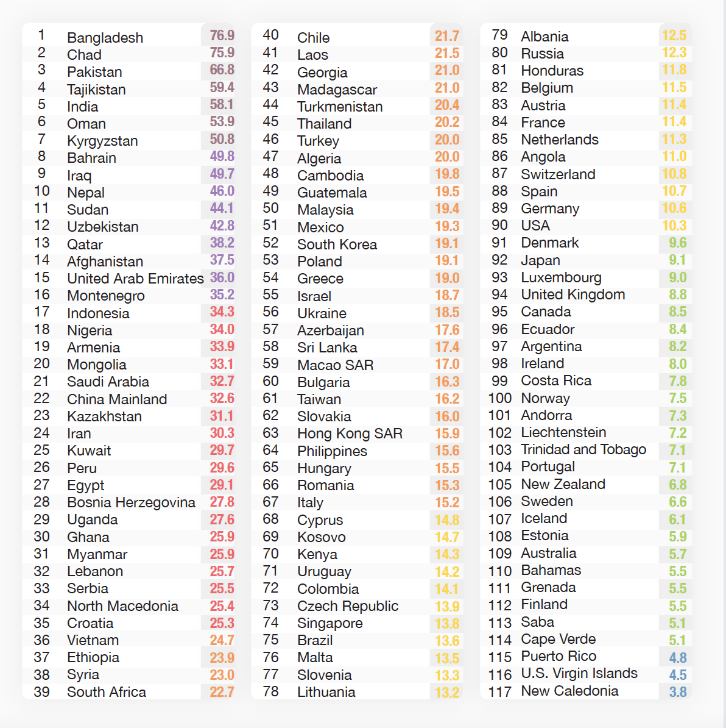
Cities of Central Asia:
New hotspots of air pollution in the world
The most polluted countries in the world based on PM_{2.5} exposure:
PM_{2.5} levels in Central Asia cities exceeded the WHO annual limit (5 μg/m³) by 4–13 times.
4th – Tajikistan
7th – Kyrgyzstan
12th – Uzbekistan
23rd – Kazakhstan
44th – Turkmenistan
Annual PM_{2.5} concentrations data from US Embassy (ВАМ – 1020) from 2018 to 2021
Source: https://www.iqair.com/us/world-air-quality-report
Source: Tursumbayeva et al., 2023.

Slide 3
What's wrong with monitoring?
Limited availability of reliable ground-based air quality measurements
Outdated air pollutant limits
PM_{2.5} Source apportionment studies have not been conducted
The lack of coal consumption data

Slide 4
WHO, EU, and Kazakhstan limit values for pollutants in the air
Air pollutant | EU limits* | Kazakhstan limit **
PM_{2.5} | 5 μg/m³ (annual) 15 μg/m³ (24 h) | 160 μg/m³ (single measurement) 35 μg/m³ (24 ч)
PM₁₀ | 15 μg/m³ (annual) 45 μg/m³ (24 h) | 300 μg/m³ (single measurement) 60 μg/m³ (24 ч)
NO₂ | 10 μg/m³ 3 (annual) 25 μg/m³ (24 h) | 200 μg/m³ (single measurement) 40 μg/m³ (24 ч)
SO₂ | 40 μg/m³ (24 h) | 500 μg/m³ (single measurement) 50 μg/m³ (24 ч)
CO | 10 mg/m³ (8 h) | 5 mg/m³ (single measurement) 3 mg/m³ (24 h)
O₃ | 100 μg/m³ (8 h) | 30 μg/m³ (24 h) 160 μg/m³ (single measurement)
* https://ec.europa.eu/environment/air/quality/standards.htm ** https://adilet.zan.kz/rus/docs/V1500011036

Slide 5
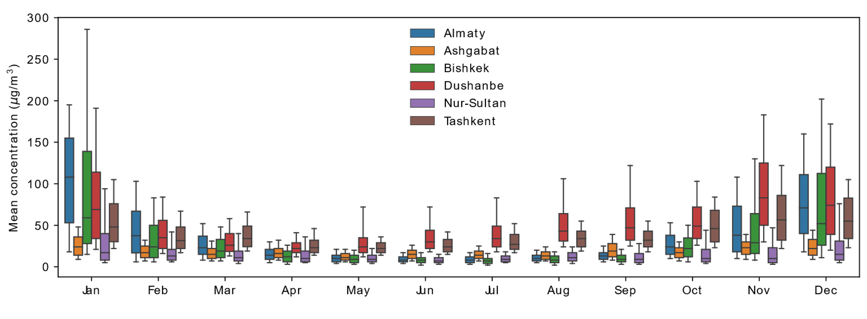
Higher PM_{2.5} concentrations in winter in the cities of СA could be associated with the increase in energy demand for heating
Source: Tursumbayeva et al., 2023.

Slide 6
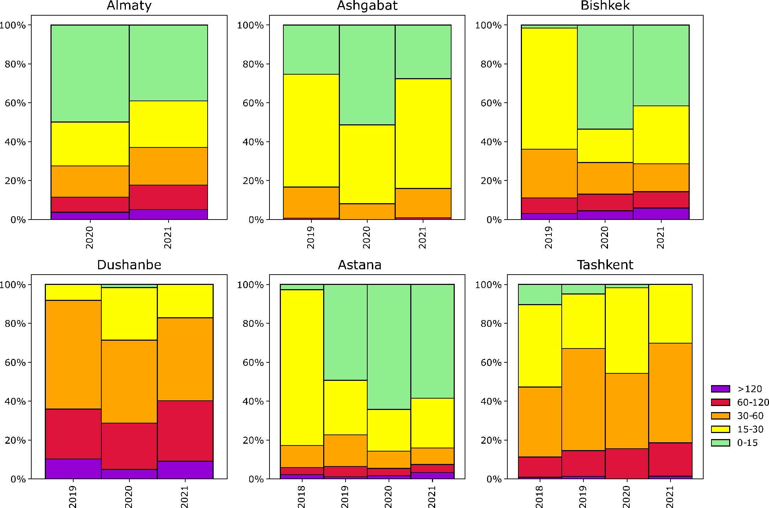
Daily PM_{2.5} concentrations
In 2021, the share of days PM_{2.5} concentrations > WHO 24-hour limit (15 μg/m³) was
42% in Astana
61% in Almaty
Most "polluted" days (>15 μg/m³) were registered in winter:
98% of days in Almaty
90% of days in Astana
Daily concentrations over 120 μg/m³ (8-fold exceeding the WHO limits)
5% in Almaty
3% in Astana of the days in a year
The frequency of days by the ranges of the average daily concentration of PM_{2.5}:
0-15 μg/m³; 15-30 μg/m³; 30-60 μg/m³; 60-120 μg/m³; >120 μg/m³.
Source: Tursumbayeva et al., 2023.

Slide 7
Premature mortality due to air pollution in Central Asian countries
was 61 – 89 people per 100,000 of population in 2021
Total economic damage due to premature deaths from air pollution
https://www.euro.who.int/__data/assets/pdf_file/0004/276772/Economic-cost-health-impact-air-pollution-en.pdf#:~:text=the overall annual economic cost,stood at US%24 1.575 trillion.

Slide 8
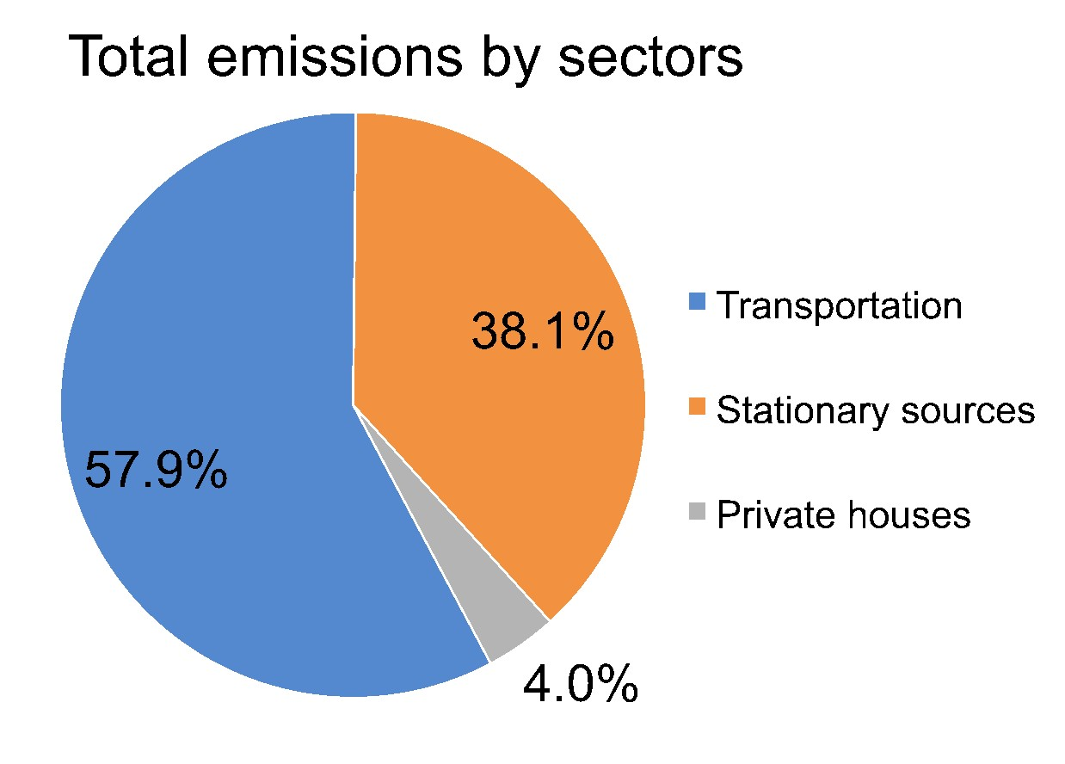
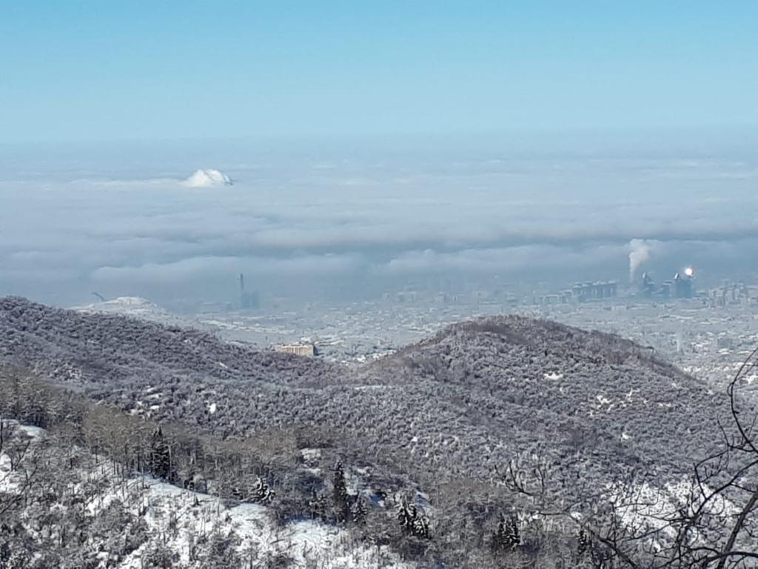
Official inventory estimations of pollutant emissions:
Incorrect inventory methodology
Based on Official inventory estimations, transportation is the main source of air pollution :
  Almaty - 52%
  Dushanbe - 60%
  Astana - 55%
  Tashkent - 90%
Air pollutant emissions (PM, SO₂, NO₂, CO, and others) are summed up without consideration of the toxicity of each pollutant.
Emissions inventory study for Almaty, Kazakhstan
Source: EcoExpert, 2020.

Slide 9
Inventory estimations in the US, Canada, China, and the EU share of air pollutant emissions by the source is presented separately for each pollutant
EPA, 2022;
European Environment Agency, 2022;
Government of Canada, 2022.
Source: Our Nation’s Air. Trends through 2022 by EPA. https://gispub.epa.gov/air/trendsreport/2023/#air_pollution.

Slide 10
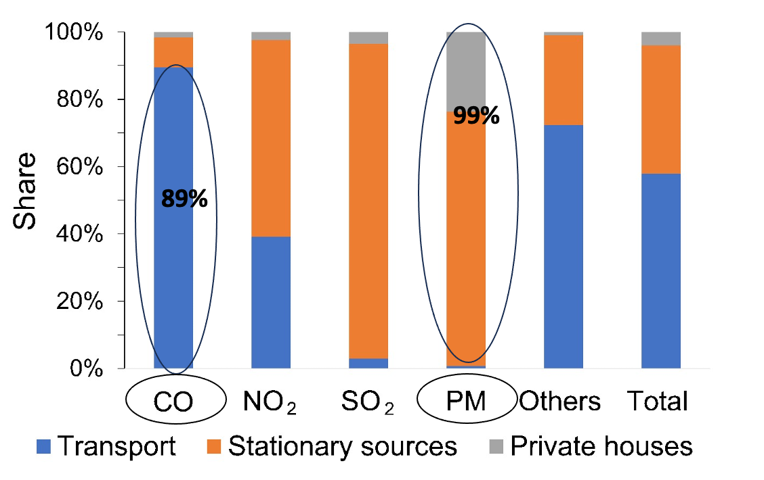
Official inventory estimations of pollutant emissions in Almaty, Kazakhstan
Emissions by sources presented by each pollutant separately
Notes:
89.5% of CO emissions, whereas stationary sources and private houses contribute 8.9% and 1.6% of CO emissions, respectively. The impact of PM2.5 on human health surpasses that of CO per unit of mass. The WHO daily limit for CO concentration is 4000 μg/m3, whereas the daily limit for PM2.5 is about 250-fold lower at 15 μg/m3. Thus, summing up all types of pollutants and then calculating the share of the contribution from the transportation sector to the total air pollution provides a misleading representation of pollution sources. This approach results in ineffective measures to combat air pollution while overlooking the primary PM sources. I

Slide 11
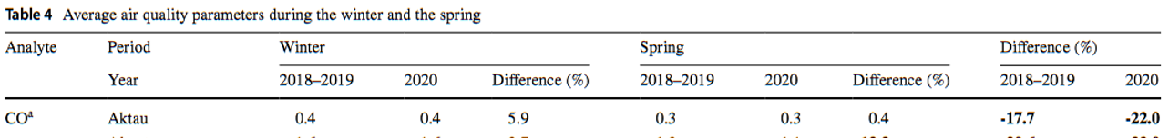

PM_{2.5} concentrations during the lockdown
Data source - US Embassy
  Data source - Kazhydromet
Source: Tursumbayeva et al., 2023, Baimatova et al., 2022.

Slide 12
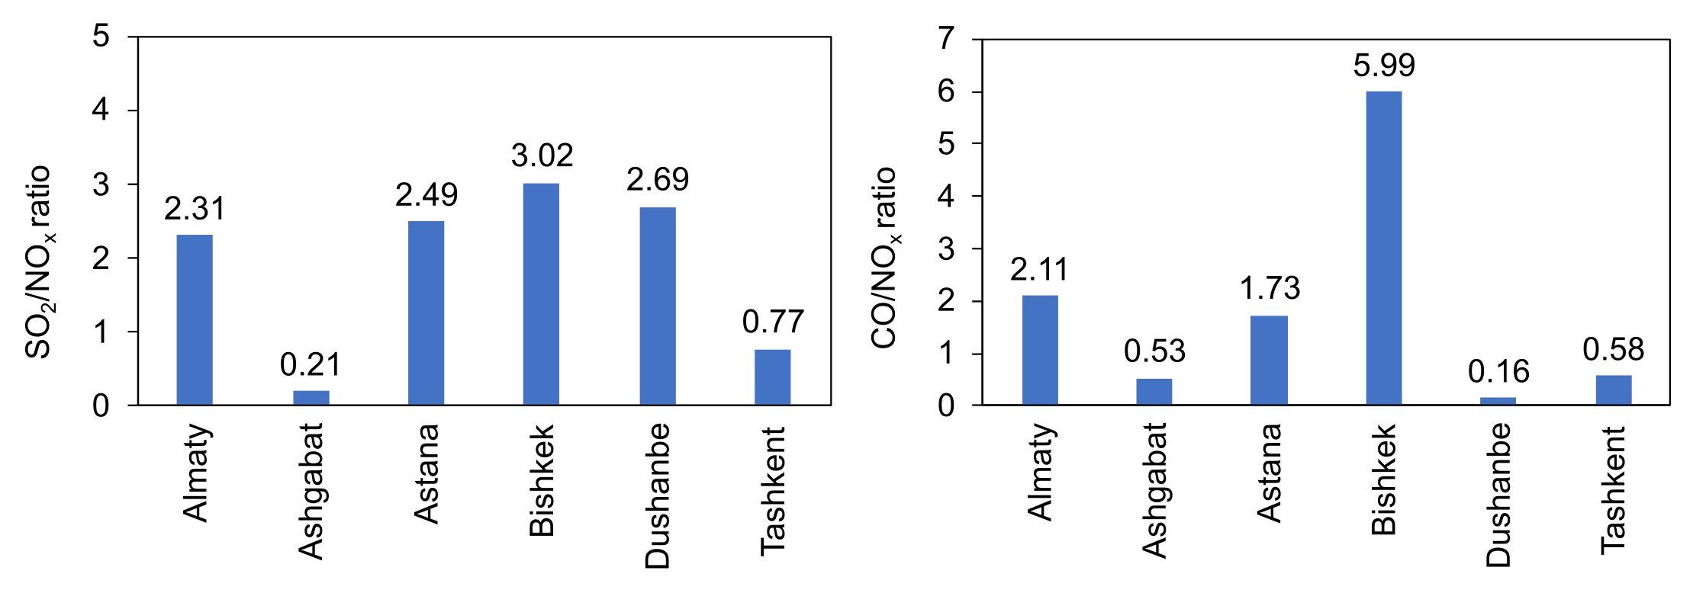
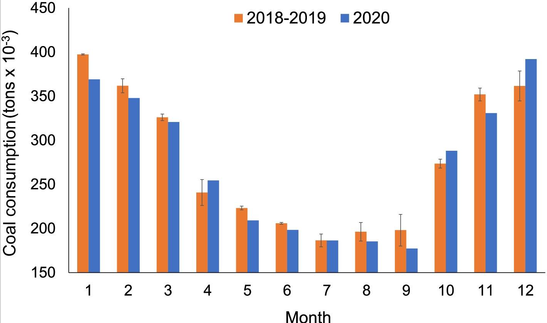
Main contributors of PM_{2.5}
Based on the ratio analysis:
mobile sources are characterized by high CO/NOx (≥10) and SO₂/NO_{x} (≤0.6) ratios
stationary sources have high SO₂/NO_{x} (≥0.6) and low CO/NO_{x} ratios (≤10) (Halim et al., 2018)
SO₂/NO_{x} and CO/NO_{x} ratios from EDGAR emission database
Daily coal consumption in tones at the CHP-2 and CHP-3 in Almaty in 2018–2019 and 2020 (Baimatova et al., 2022)
Notes:
In our study, the high SO₂/NOx and low CO/NOx ratios in all considered cities, except Ashgabat, suggest that the air quality of these cities was significantly impacted by stationary sources.

Slide 13
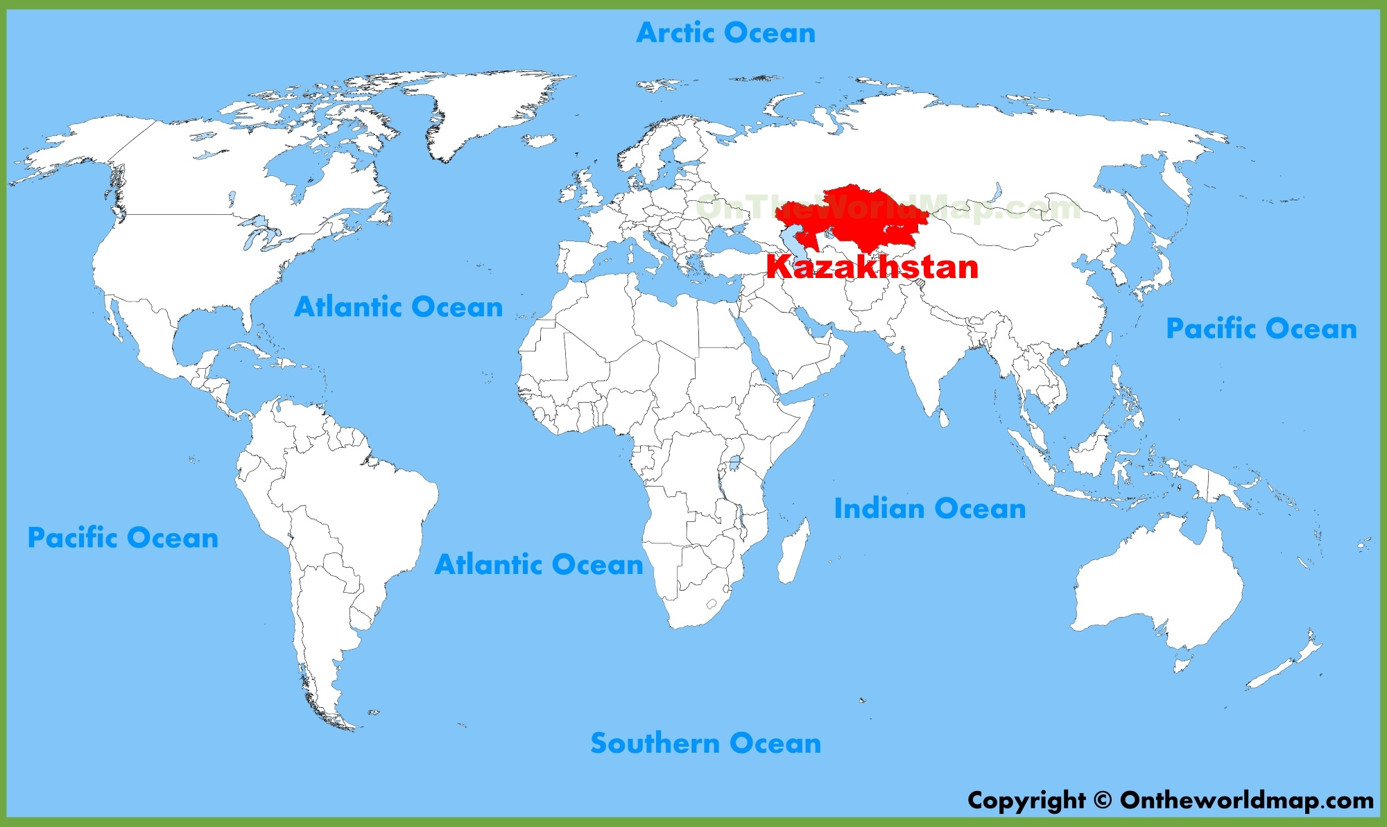
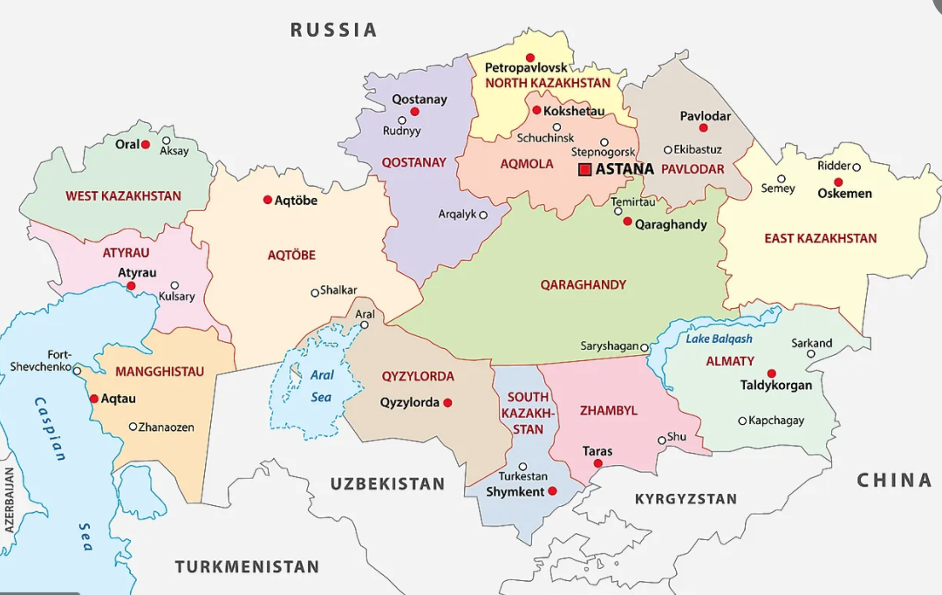
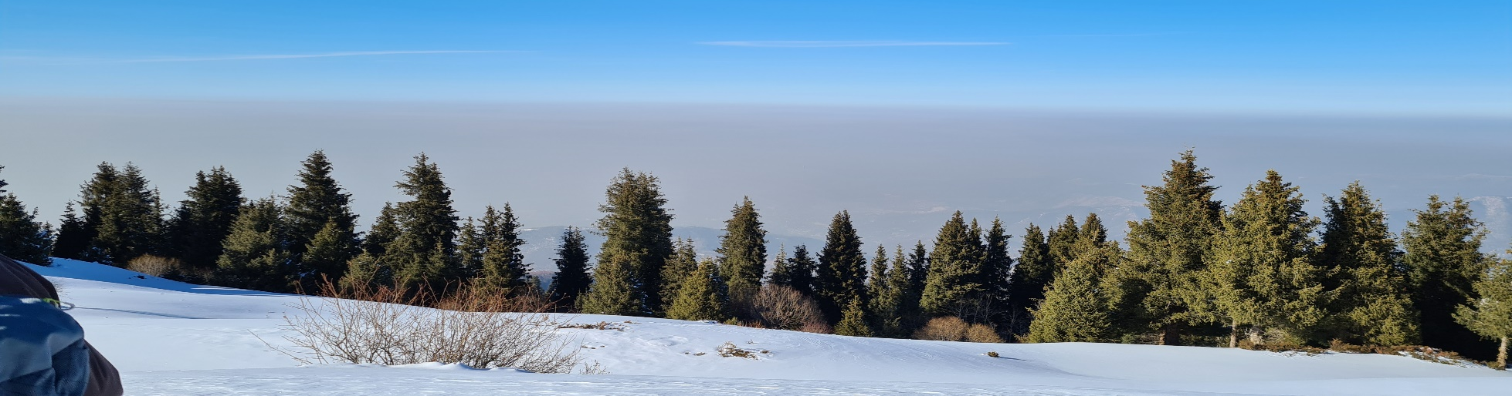
Air pollution in Kazakhstan
The view of Almaty from mountains, November 25, 2021

Slide 14
Potential sources of air pollution
Coal-fired power plants, domestic heating stoves using coal, and vehicle exhaust (Kerimray et al., 2020).
Desert dust and mineral dust (Abdullaev and Sokolik, 2020; Hofer et al., 2017).
Vehicle exhaust, coal-fired power plants, and coal usage by private houses for heating (Isaev et al., 2022).
Coal-fired stoves, power plants, and industries (Assanov et al., 2021).
https://ecomuseum.kz/activities/kachestvo-vozdukha/istochniki-zagryazneniya-vozdukha/index.php

Slide 15

Kazakhstan is the largest and economically stable country with an above–average income in CA
Kazakhstan is in top 10 countries in terms of coal reserves, with 33.6 billion tons across 400 deposits, of which 29.4 billion tons are proven and probable (2.4% of the world's total).
Annual production was 109.2 million tones of coal and lignite from which 80% were consumed in domestic market and 20% was exported (Kazenergy, 2021)

Slide 16
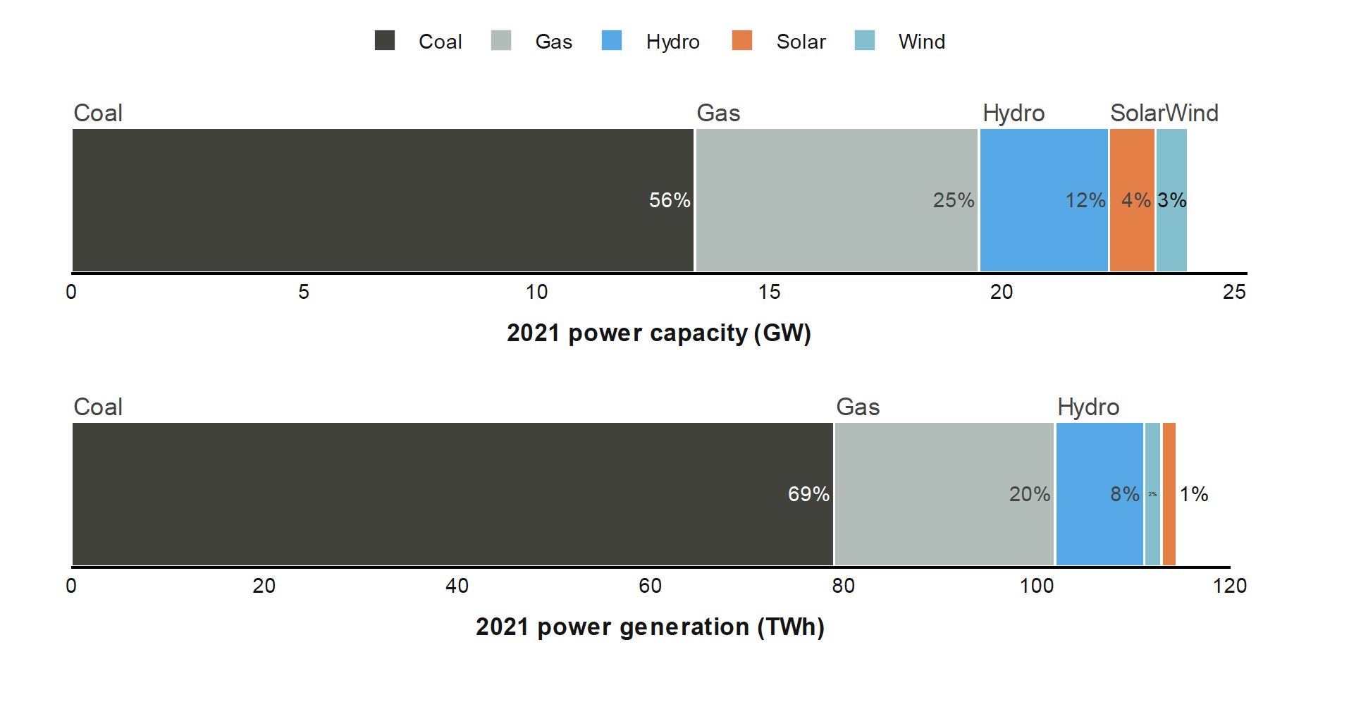
Kazakhstan installed capacity and electricity production
www.carbontracker.org .Kazakhstan Energy Transition
The power system is dominated by coal-fired power plants, which accounted for 56% of installed capacity and 69% of generation in 2021.
Gas power is the next dominant source accounting for 25% of capacity and 20% of generation in 20218.
Source: KEGOC Annual Report 2021, CTI

Slide 17
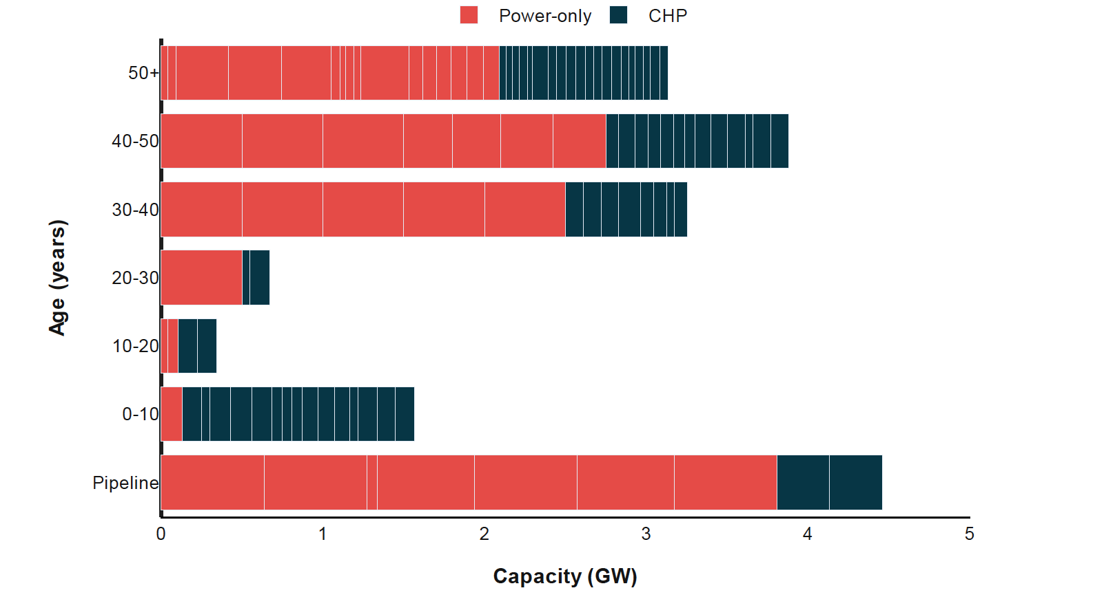
The average wear of 37 Coal-fired power plants operating in Kazakhstan is 66%
www.carbontracker.org .Kazakhstan Energy Transition
The emissions from Kazakhstan's CHPs exceeded the limits of European countries
by over 10 times for PM,
over 20% for NOx,
and up to 2.5-fold for SOx (Tursumbayeva et al., 2023)

Slide 18
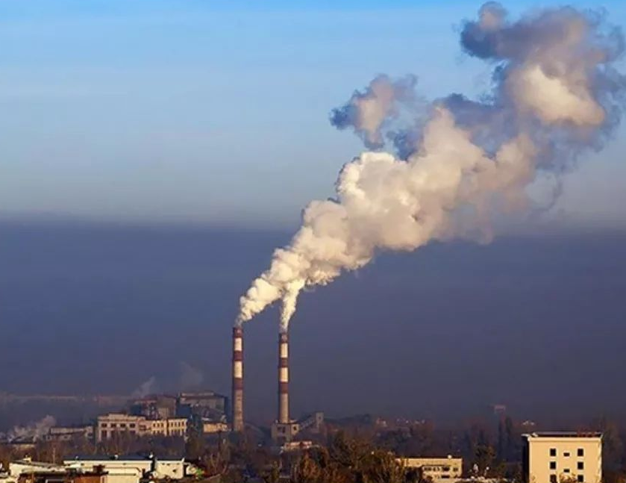
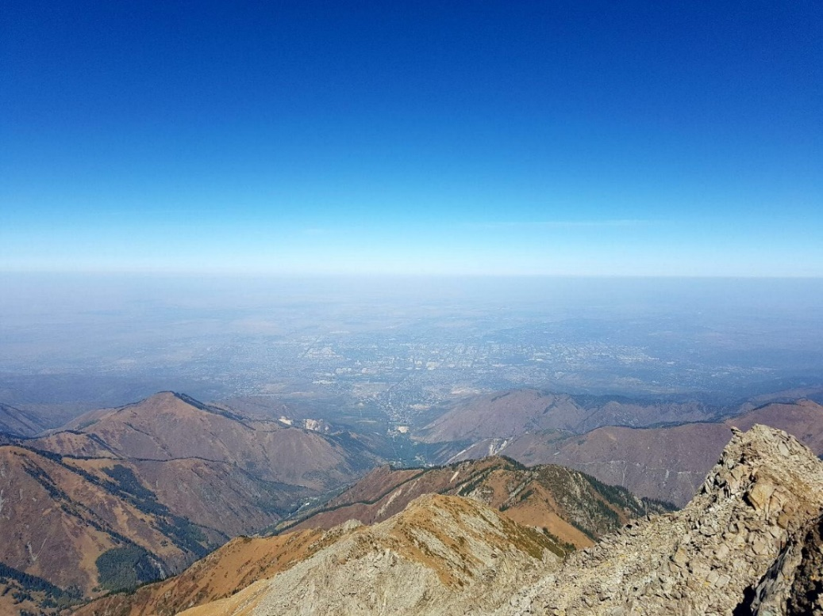
The air quality in Almaty is one of the lowest in Kazakhstan
Electricity and heat in Almaty are provided by three Combined Heat and Power Plants. The CHP-1 uses natural gas as a fuel, while CHP-2 and CHP-3 – low-grade coal (42% ash content)
The health damage from air pollution in Kazakhstan amounts to $12 billion or 6.7% of GDP¹
Almaty 8th most polluted city by BTEX in 20 major cities worldwide²
The number of studies based on the assessment of air quality in Almaty is very limited and monitoring program determines only two VOCs (formaldehyde, phenol)
1. World Bank. The Global Health Cost of PM2.5 Air Pollution: A Case for Action Beyond 2021. International Development in Focus. Washington, DC: World Bank.
2. Carlsen L., Kenessov B.N., Baimatova N.K., Kenessova O.A. Assessment of the Air Quality of Almaty . Focussing on the Traffic Component // International Journal of Biology and Chemistry. - 2013. - Vol. 1 (5). - P. 49–69.

Slide 19
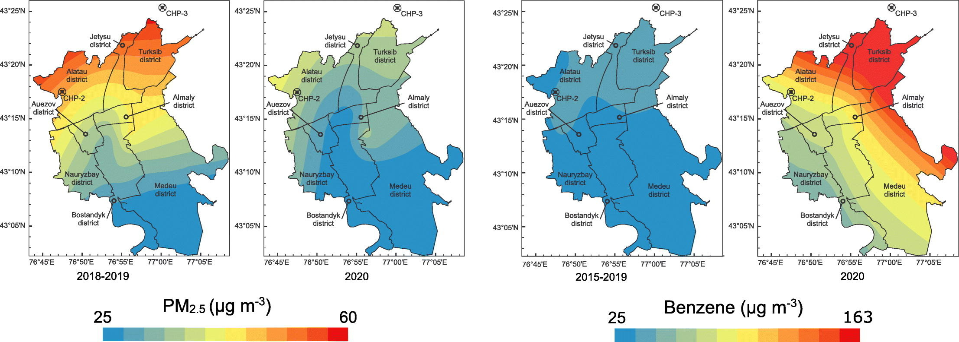
Assessing air quality changes in Almaty during COVID-19 lockdowns
PM_{2.5} concentration reduced by 21% with spatial variations of 6–34% compared to the average of the same days in 2018–2019
CO and NO₂ concentrations reduced by 49% and 35%, respectively.
O₃ concentrations increased by 15% compared to the preceding 17 days before the lockdown.
Concentrations of benzene (101 µg/m³) and toluene (67 µg/m³) were 3 and 2 times higher in 2020 than in the same seasons of 2015–2019
Concentrations of ethylbenzene (1.0 μg/m³) and o-xylene (1.6 μg/m³) were 4 and 2.7 times lower in 2020
Traffic-free conditions could not cause substantial reductions in pollution levels since several primary emission sources dominate the pollution profile over the city.
Source: Kerimray et al, 2020.

Slide 20
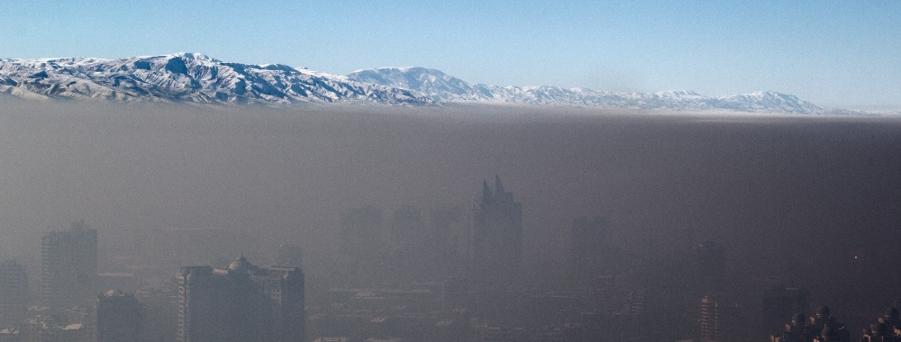
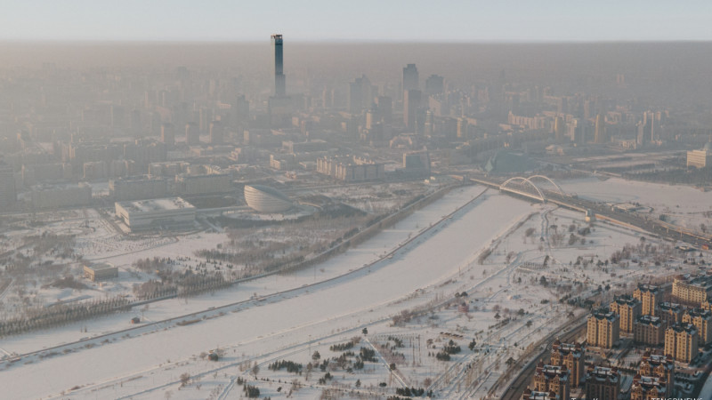
Mortality and economic costs of air pollution in 2022 attributable to exposure to high concentrations of PM_{2.5}
  1,786-2,342 deaths
  84-111 deaths per 100,000 population
      $970 – $5,877 million
      2.8%-16.8% of GRP
Almaty
  557-750 deaths or
  43-58 deaths per 100,000 population
      $308 – $1,881 million
      1.6%-9.5% of GRP
Astana
Data source: Baimatova et. al, BR10965258

Slide 21
Information on sources of air pollution is crucial
Estimation of the effectiveness of emission reduction policies (before and after).
Determinations of the contribution of natural sources and anthropogenic sources of emissions.
Air quality improvement plans.
Quantifying transboundary pollution.
Public Awareness.

Slide 22
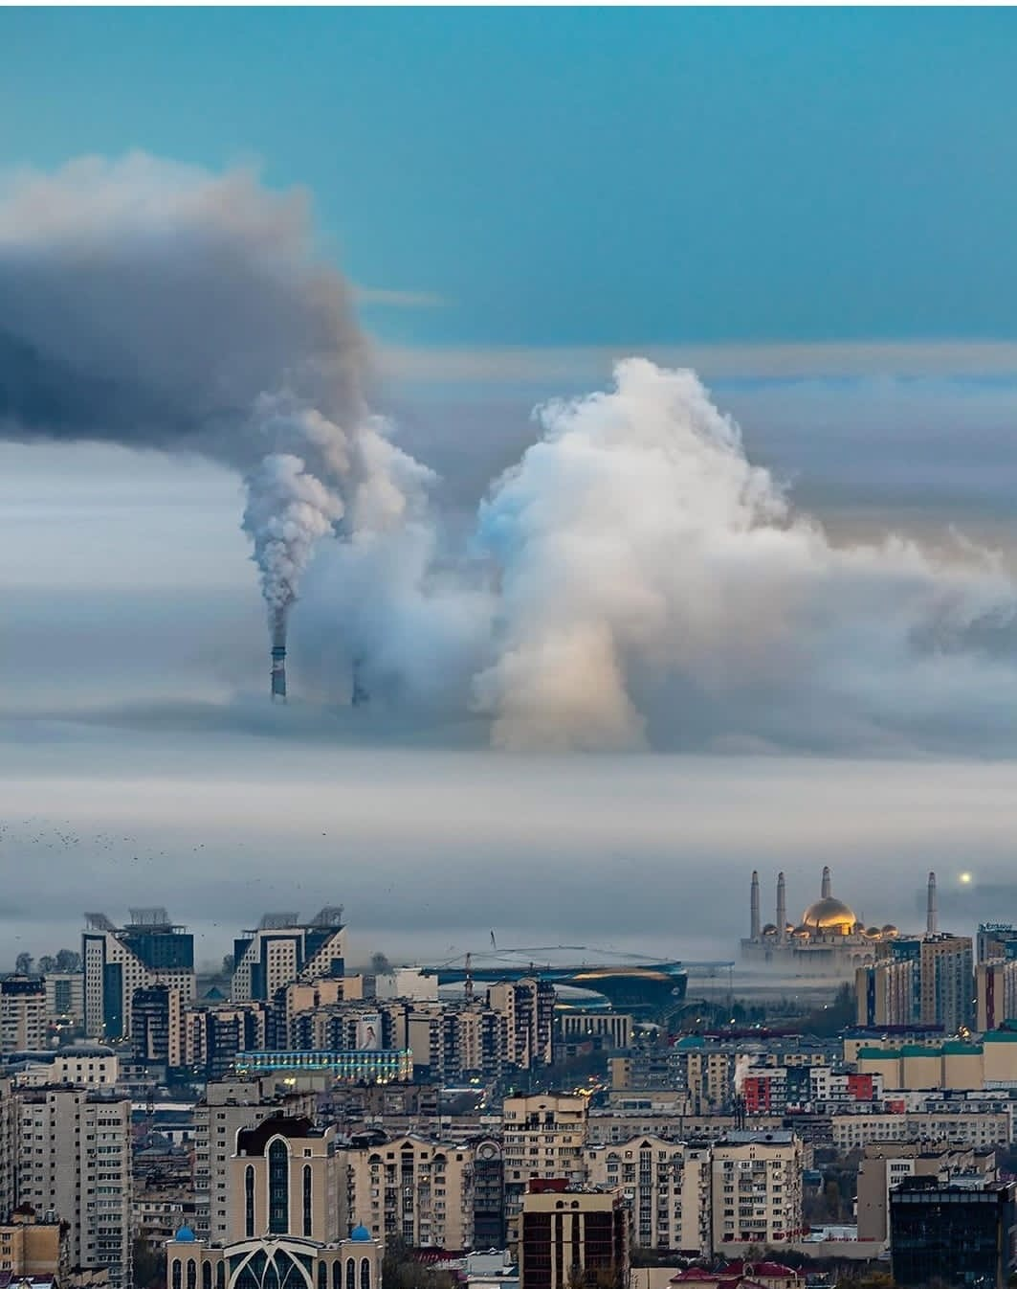


Thank you for your attention!
BR10965258
Photo credits: @Dots_foto

