Slide 1
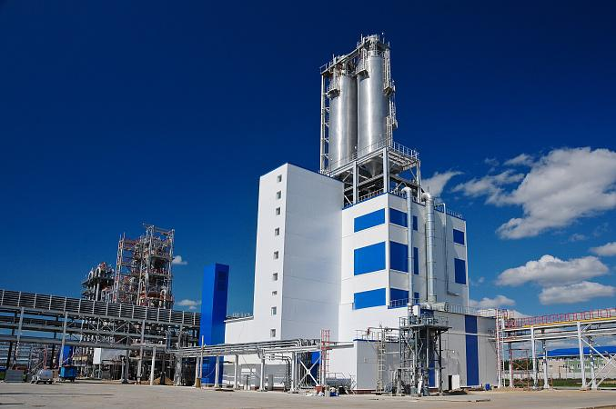
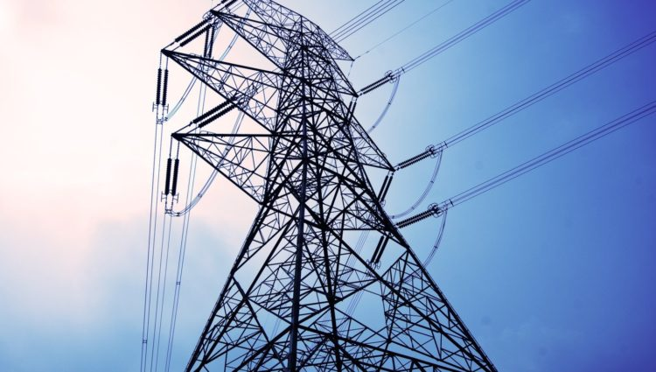
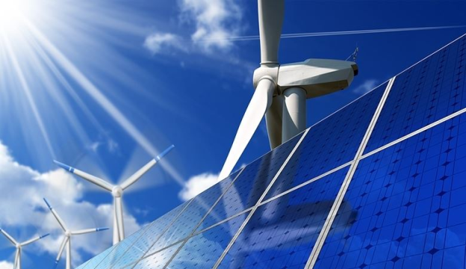
MINISTRY OF ENERGY OF THE
REPUBLIC OF KAZAKHSTAN
Developments in the energy sector of the Republic of Kazakhstan

Slide 2
Структура генерации
MINISTRY OF ENERGY OF THE REPUBLIC OF KAZAKHSTAN
2
213
power plants
24,77 GW
As of November 2023, Kazakhstan has 141 RES facilities with a capacity of 2,715.8 MW (excluding large hydropower plants)
Installed capacity
Kazakhstan’s generation structure
Solar
1197 MW
44 PPs
Wind
1246,6 MG
55 farms
Hydro
269,6 MW
39 PP
BioPP
1,77 MW
3 PP
Bid HPPs
Gas
RES
Coal
Electricity generation/consumption dynamics in Kazakhstan billion kWh.
plan
Generation
Consumption
plan

Slide 3
Sector reforms
MINISTRY OF ENERGY OF THE REPUBLIC OF KAZAKHSTAN
3
Electricity purchase and sale process description
Generator
(CHP)
RES, new PPs (оfftake)
Generator
(free capacity)
RF
(constrained import)
1
2
3
4
Direct sale out of bidding (по пред. тарифам)
Direct sale out of bidding (at fix price)
Centralized bidding (not higher than prev. tariffs.)
In case of shortage (at RF’s prices)
A single buyer buys at different prices, then averages a single price to charge consumers
4
3
Wholesale consumers, ESCs
2
1

Slide 4
Реформы в отрасли
MINISTRY OF ENERGY OF THE REPUBLIC OF KAZAKHSTAN
4
Sector reforms
INTRODUCTION OF BALANCING ELECTRICITY MARKET
Key principles
Physical and financial resolution of imbalances in the energy system
Introduction of targeted financial responsibility of entities for created imbalances in the energy system
Introduction of hourly tariff differentiation – smoothing of peak load
Impact
Smoothing of peak load in the power system
Reducing dependence on neighboring power systems
Reducing the impact of unstable RES on the daily schedule

Slide 5
Industry development perspectives
MINISTRY OF ENERGY OF THE REPUBLIC OF KAZAKHSTAN
5
Kazakhstan's Concept on the Development of the Electric Energy Industry
for 2023-2029
Energy balance
2035
Commissioning of new capacities
MEETING THE ELECTRICITY NEEDS OF THE ECONOMY AND POPULATION
100 %
ATTRACTING INVESTMENTS IN THE ELECTRIC POWER INDUSTRY
Up to 7.5 KZT trillion
MODERNIZATION OF EXISTING FACILITIES AND CONSTRUCTION OF NEW FACILITIES
Up to 11,7 GW
COMPLETION OF THE UNIFIED ENERGY SYSTEM OF THE COUNTRY
100 %
REDUCTION OF WEAR AND TEAR OF GENERATING CAPACITIES
up to 43 %
Up to 47 %
REDUCED DEPRECIATION OF POWER GRIDS
INCREASE IN THE VOLUME OF ELECTRICITY GENERATION FROM RENEWABLE ENERGY SOURCES COMPARED TO 2022
2.8 times
Total: 17.4 GW

Slide 6
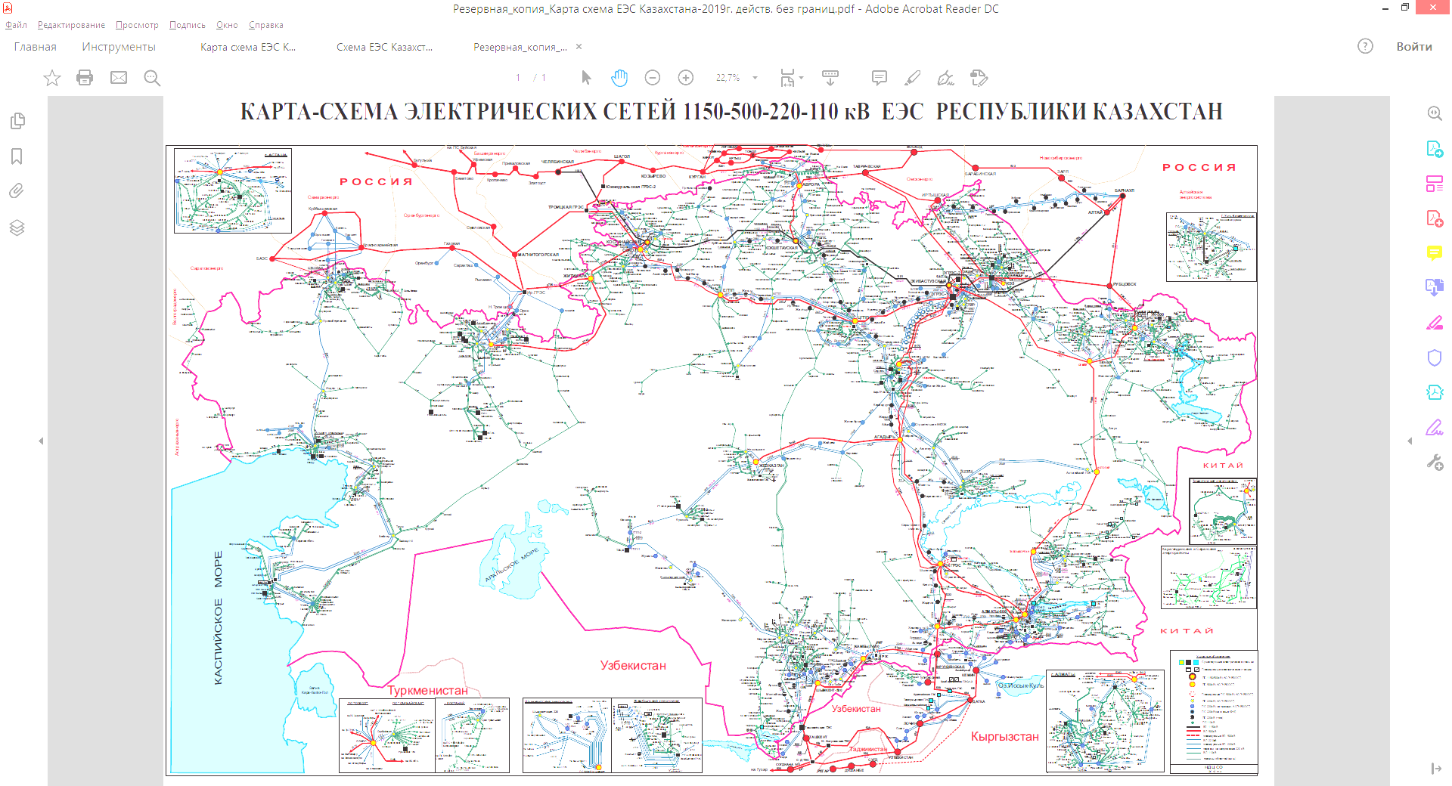
Generation commissioning plan until 2029
План по вводу генерации до 2029 года
MINISTRY OF ENERGY OF THE REPUBLIC OF KAZAKHSTAN
6
WPP auctions – 300 MW
WPP auctions– 1100 MW
Kokshetau CHP 240 MW
Ekibastuz TPP -2
1200 MW
Ekibastuz TPP-1 500 MW
WPP auctions - 800 MW
WPP auctions – 800 MW
WPP auctions – 200 MW
SPP auctions– 20 MW
Semey HPP up to 300 MW
Shulbinskaya HPP
150 MW
ANPS CCGT 300 MW
WPP auctions – 500 MW
Аукционы ГЭС – 2170 MW **
Semey CHP 320 MW
ANPS CCGT 154 MW
KUS CCGT
310 MW
BioPP Auctions - 50 MW **
Kalamkas CCGT
36 MW
AcwaPowerCompany RES up to 1 GW
CCGT Kyzylorda
240 MW
WPP auctions – 300 MW
SPP auctions– 100 MW
SPP auctions– 100 MW
ENI CCGT 240 MW
CCGT Turkestan
1000 MW.
Masdar RES
1 GW (1 stage - 500 MW)
HPP
1200 MW
Kerbulak HPP 50 MW
MAEK CCGT
up to 500 MW
SPP auctions– 100 MW
CPIH RES - 1 GW*
SPP auctions– 80 MW
ALES CCGT 1300 MW
* - The possibility of project capacity distribution in several territories is being considered.
** - Auctions for selection of HPP and BioPP projects are held throughout the country
SPP auctions– 100 MW
Total Energies RES
1 GW

Slide 7
Generation commissioning plan until 2029
MINISTRY OF ENERGY OF THE REPUBLIC OF KAZAKHSTAN
7
Regional 110-220 kV grid development zones
Regional 110-220 kV grid development zones
Ekibastuz
Aktobe
Astana
Перспектива развития НЭС
Compressor station
Atyrau
BBS – 2 leg
DC line
Compressor station
Regional 110-220 kV grid development zone
Regional 110-220 kV grid development zones
Towards Azerbaijan
Beineu-Bozoi-Shymkent gas pipeline
DC line
500 kV overhead lines
Saryarka gas pipeline
HVDC link
220 kV overhead lines

Slide 8
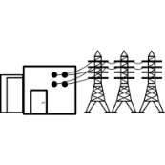
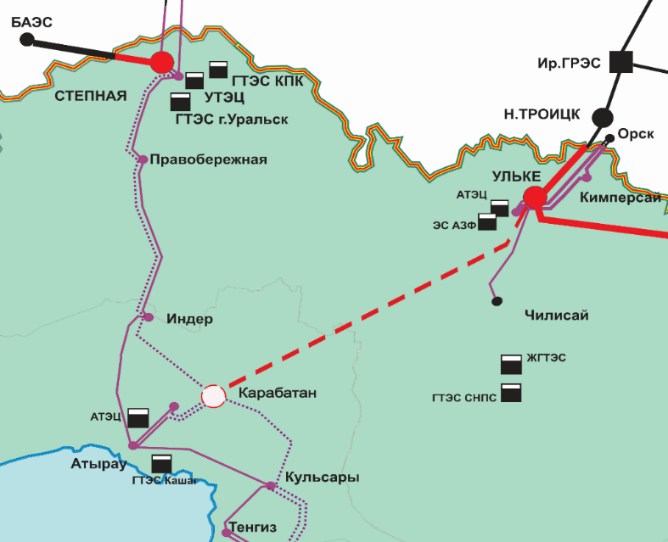
Projects planned for implementation in the Western Zone
MINISTRY OF ENERGY OF THE REPUBLIC OF KAZAKHSTAN
9
”Integration of the Western zone into UES of Kazakhstan"
Project cost: estimated 164 billion KZT )pending feasibility study)
Commissioning period until 2028
Effect: Unification of the Western Zone with the main part of UES of Kazakhstan through the territory of Kazakhstan.
Current status: Feasibility study of the project is being developed - completion date Q4 2023
Development of the design and construction documentation - 2024-2025.
Construction and installation works - 2025-2027
Power grid construction
Construction of 500 kV overhead line Karabatan substation - Ulke substation
Construction of 500 kV switchgear at Karabatan substation with installation of 3*167 MVA autotransformer and shunt reactor, Controlled shunt reactors.
Expansion of 500kV Ulke substation with installation of the second group of 167 MVA ATs with shunt reactor and controlled shunt reactors

Slide 9
Implementation of the RES development policy
МИНИСТЕРСТВО ЭНЕРГЕТИКИ РЕСПУБЛИКИ КАЗАХСТАН
Реализация политики ВИЭ
MINISTRY OF ENERGY OF THE REPUBLIC OF KAZAKHSTAN
10
Share of RES in the total volume of generation
2009
Beginning of RES development in the country
First legislative initiatives to support RES
50
*
%
Concept for the transition of the Republic of Kazakhstan to a "green" economy (2013)
Application of fixed tariffs for RES sources (2014)
2013-2015
15
%
6
Introduction of an auctioning mechanism for competitive selection of RES projects
Amendments were made to the current legislation in the RES sector support
%
2018
Forecast electricity balance of the Unified Electricity System of Kazakhstan until 2035
Finalization of the law on RES support (exemption from property tax and land tax, also exemption from corporate income tax)
2020-2023
2025
2030
2050
* including alternative energy sources

Slide 10
Auctions for selection of projects for RES construction (2018-2022).
MINISTRY OF ENERGY OF THE REPUBLIC OF KAZAKHSTAN
11
Auction results
Lower auction prices
WPP | 2018 | 2019 | 2020 | 2021 | 2022
Starting price, KZT | 22,68 | 22,66 | 21,69 | 21,53 | 21,53
Min. price, KZT | 17,39 | 19,27 | 15,9 | 14,08 | 12,39
price reduction % | 23,3 % | 15,0% | 26,7% | 34,6% | 42,45%
2395 MW
Auctioned capacity
SPP | 2018 | 2019 | 2020 | 2021 | 2022
Starting price, KZT | 34,61 | 29 | 16,97 | 16,96 | 16,96
Min. price, KZT | 18 | 12,49 | 14,58 | 12,87 | 16,95
price reduction % | 48% | 57% | 14,1% | 24% | 0,05%
232 companies from 13 countries
Participants
64 companies
HPP | 2018 | 2019 | 2020 | 2021 | 2022
Starting price, KZT | 16,71 | 15,48 | 15,48 | 15,2 | 15,48
Min. price, KZT | 12,8 | 15,43 | 13,48 | 15 | 15,48
price reduction % | 23,4% | 0,3% | 12,9% | 1,4% | -
Signed a contract with FSC

Slide 11
Legislative conditions for RES development
MINISTRY OF ENERGY OF THE REPUBLIC OF KAZAKHSTAN
12
Guaranteed purchase of all electricity generated and supplied to the grid
Distribution of RES power through the Financial Settlements Center (FSC) to conditional consumers
Increase of PPA duration from 15 to 20 years
Contract on connection to the grid of RES facilities
Reserved land plots and grid connection points
Provision of investment preferences under the Entrepreneurship Code
Financial support to FSC in case of default risk
Annual indexation of tariffs
Establishment of a reserve fund at the FSC
INVESTOR’S GUIDE TO RENEWABLE ENERGY PROJECTS IN KAZAKHSTAN
KOREM JSC's website: https://auction.korem.kz/rus/investor/ruk_investora/
Financial Settlement Center of Renewable Energy LLP: https://rfc.kegoc.kz/auctions/materials

Slide 12
Plan of auction trades
MINISTRY OF ENERGY OF THE REPUBLIC OF KAZAKHSTAN
13
Maximum auction prices, tenge/kWh.
2023 | 2024 | 2025 | 2026 | 2027
500 MW | 700 MW | 800 MW | 1000 MW | 1000 MW
250 MW | 560 MW | 430 MW | 480 MW | 450 MW
100 MW | 100 MW | 100 MW | 100 MW | 100 MW
10 MW | 10 MW | 10 MW | 10 MW | 10 MW
860 | 1370 | 1340 | 1590 | 1560
22.68 kWh ($0.047)
WPP
41.23 kWh ($0.086)
СЭС
Био
HPP
34.61 kWh ($0.072)
SPP
32.23 kWh ($0.067)
BioPP
Total:
installed capacity by 2027: 6.7GW

